Slide 1

Presentation Template
LINE MANAGER TRAINING
This presentation is a template for training line managers on road safety
You may wish to use it without adding anything to it
However, it will be better if you add to it, to make it more relevant to your situation
It is designed for you to be able to add images which show local traffic, or images from your own operations
You may also wish to add slides explaining the internal rules you apply in your own company
For free eLearning modules visit https://roadrisktoolkit.com/
For advice on further training contact:
mail@roadrisktoolkit.com

Slide 2


Line Manager Training

Slide 3
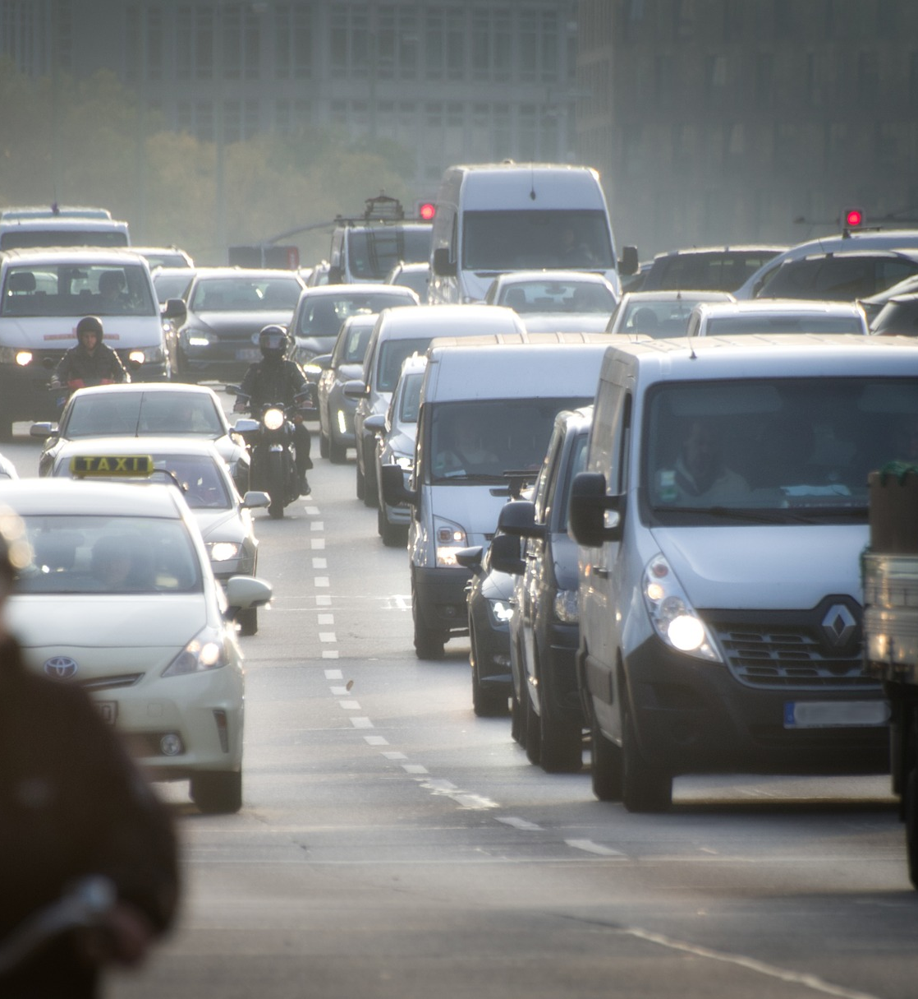
Agenda
The scale of the problem
Why manage work-related road risks?
The biggest risks
Effective work-related road risk management
Line Manager roles & responsibilities
Engaging with drivers
Post-incident debriefs

Slide 4

The Scale of the Problem
Notes:
This section of the presentation looks at the scale of the road safety problem around the World.

Slide 5
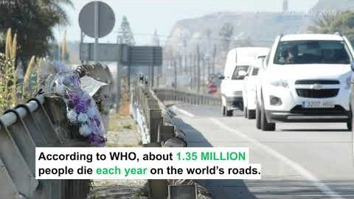
Notes:
Video introduction highlighting the true scale of the road safety problem around the World.
It highlights some facts and figures and talks about the Sustainable Development Goals as a framework for Governments to use to help improve road safety.

Slide 6
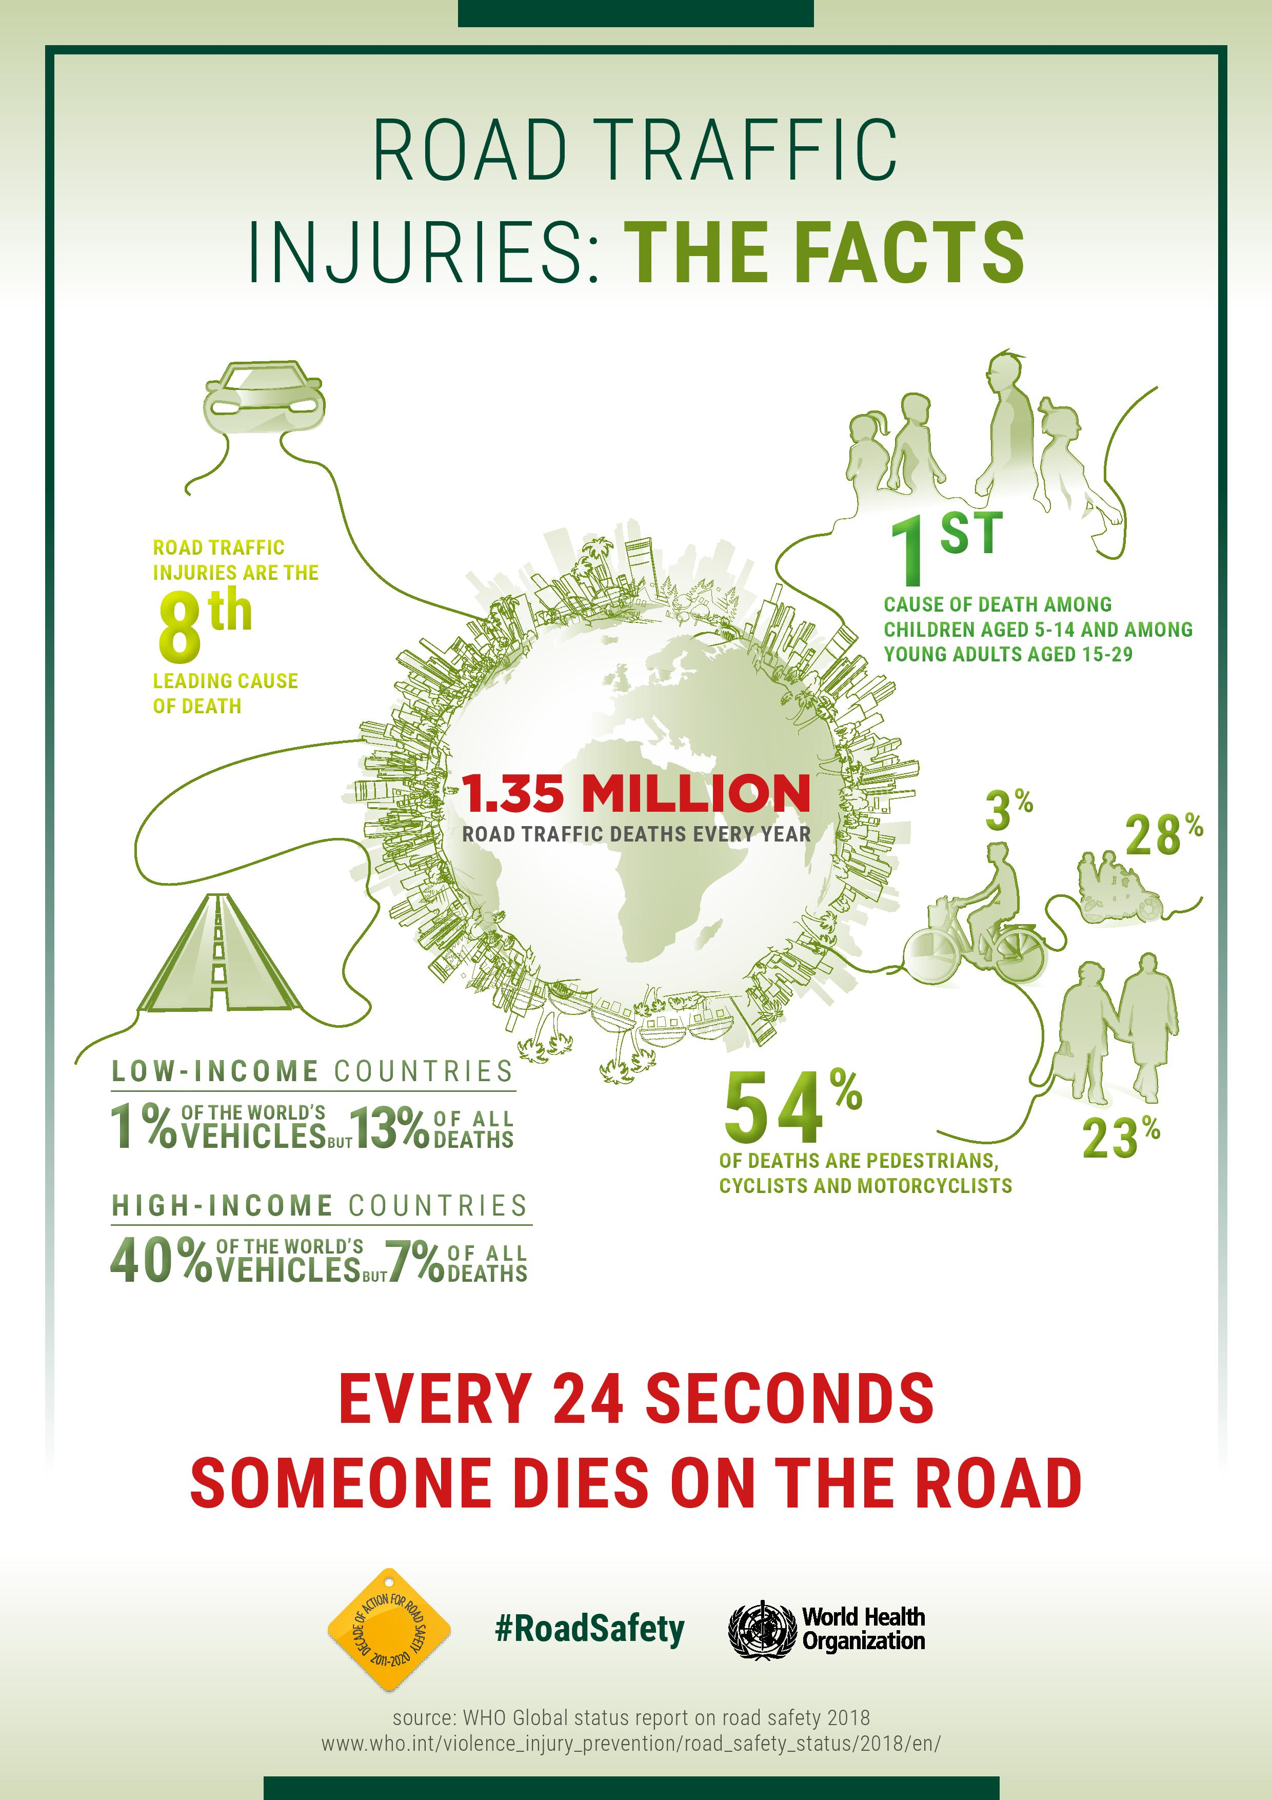
Notes:
This infographic backs up some of the information in the video and highlights where the scale of the problem in terms of Low and Middle Income countries and also the issue with vulnerable road users – pedestrians, motorcyclists and cyclists.
You should always remember that our responsibilities as Managers is to manage the health & safety of our employees AND those who they share the road with, so we should treat any collision where there have been injuries (or the potential for injuries) to any road users as seriously as where one of our employees has been injured (or the collision could have resulted in an injury).

Slide 7
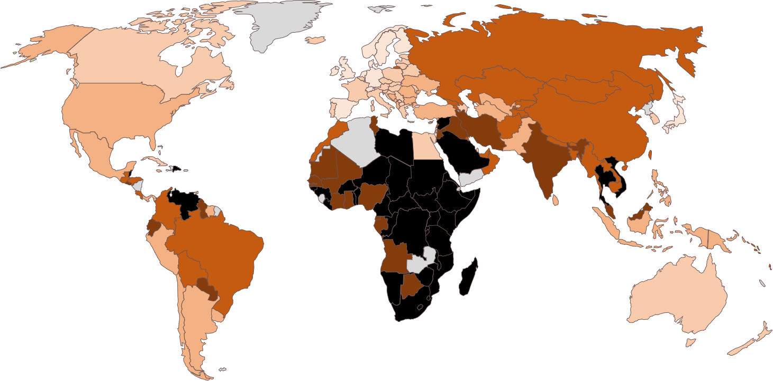
Heat map of road fatalities
Notes:
This heat map of where road fatalities occur – the darker the colour, the higher the number of fatalities per 100,000 population – helps you see where the problems lie in the countries where you are operating.

Slide 8

Why Manage Work-Related Road Risks?
Notes:
This section looks at the reasons why the Company should manage work-related road risks.
If this is being run as an interactive session, ask the reasons why here.

Slide 9
Why manage work-related road risks?
The risk of harm
The risk of prosecution
Corporate Social Responsibilities
Financial losses
Notes:
These are the fundamental reasons why any organisation should manage work-related road risks.
The next few slides look into each area in a little more depth, to provide you with insights that you can use within your business.

Slide 10
Risk of Harm
1.35 million people are killed in road crashes every year
  93% of these are in Low and Middle Income countries
  52% of fatalities are vulnerable road users – pedestrian, cyclists & motorcyclists
Follow this link to see the fatalities per 100,000 population in the countries where you operate:
https://www.grsproadsafety.org/resources/global-crash-data/
Research on ‘at work’ drivers shows that they have an increased risk of being involved in a crash even after higher mileages are taken into account.
Notes:
Remind everyone of the facts and figures that were covered earlier.
Use the link to lookup the fatality rates in the countries where you operate, to see the scale of the problem locally.
At work drivers have more crashes that private motorists, even after their higher mileages are accounted for. This may be down to the increased pressures they face from work-related activities, on top of whatever they are experiencing in their private lives.
You should also point out that it is not just road fatalities that should be of concern – it’s the millions of serious injuries too.

Slide 11
Risk of prosecution
It is not just the driver that may be liable when a collision occurs. Depending on which country you operate in, the management team could be liable if they are found to have contributed to the crash through, for example, negligence or putting unreasonable demands on the driver.
Notes:
The legal situation will vary by country, so it is not worth going into depth here, but just saying that there is a risk of prosecution if any management failings are seen by the authorities to have contributed to the collision occurring.

Slide 12
Corporate Social Responsibilities (CSR)
Not harming employees or members of the public who share the road with them
  Reminder that where a third party is injured, there could be consequences for the Company and also the psychological impact on the driver.
Being good neighbours around sites and offices
Safety-environmental synergies
Notes:
From the discussions previous about the number of fatalities and serious injuries, and the risks involved, it is clear that any organisation taking its Corporate Social Responsibilities seriously should be managing work-related road safety effectively.
Always remember that managing work-related road safety is not just about keeping your employees safe – it is about protecting members of the public who you share the road with. We’ve heard that 54% of fatalities involve vulnerable road users – pedestrians, cyclists and motorcyclists.
There are many things that are good for managing road safety that are also good for the environment, so effective work-related road risk management will help with your ‘green’ initiatives.

Slide 13
Financial issues
For every crash there will be:
  Direct losses, such as:
    Deductibles/excesses attached to the insurance policy
    Repair costs if these are not covered by insurance
    Hire costs of replacement vehicles
    etc.
  What are the indirect or hidden costs / uninsured losses?
Notes:
While preventing crashes to prevent fatalities and serious injuries should be the biggest motivator, safe driving also makes good business sense.
The direct costs will depend on the nature of your insurance policy, but might include the things listed.
If you are running an interactive session, ask what the hidden costs / uninsured losses are?

Slide 14
Uninsured losses
The International Loss Control Institute say that for every $1 / €1 / £1 paid out by an insurer there are 8-53 $ / € / £ in uninsured losses, depending on the severity of the incident. Take a moment to think about what this looks like based on your claims experience!
But what are these hidden costs? It will depend on the nature of your organisation, but will always include absenteeism – the employee will not be doing what you pay them to do, and there will be a financial impact on your business because of this. Even if your employee is not injured in the crash, you shouldn’t underestimate the psychological impact of seeing someone else killed or seriously injured in a crash – they might not be a productive member of staff for some time.
There are, of course, lots of other hidden costs – lost productivity, late deliveries, broken Service Level Agreements, increased staff turnover – the list goes on and on. What you should never forget is the hidden costs associated with reputational damage if the media associate your organisation with the crash – how much damage could that do to your business?
Notes:
This should provide an insight into the true costs to the business every time a collision occurs.

Slide 15

The Biggest Risks
Notes:
This section looks at what the biggest risks are, in terms of the chances that an employee or someone that they share the road with will be killed or seriously injured in a road crash.
If this Line Manager training is being run as an interactive session, then at this point ask the question:
“What are the main reasons why serious collisions occur?”

Slide 16
The biggest risks
Speed
Impairment
Distractions
Fatigue
Seatbelt & helmets
Notes:
These are the main reasons why collisions involving someone being killed or seriously injured occur.
There are, of course, other reasons, such as travelling too close to the vehicle in front, unsafe overtaking etc. but these often have underlying contributory factors such as fatigue, distraction etc.

Slide 17
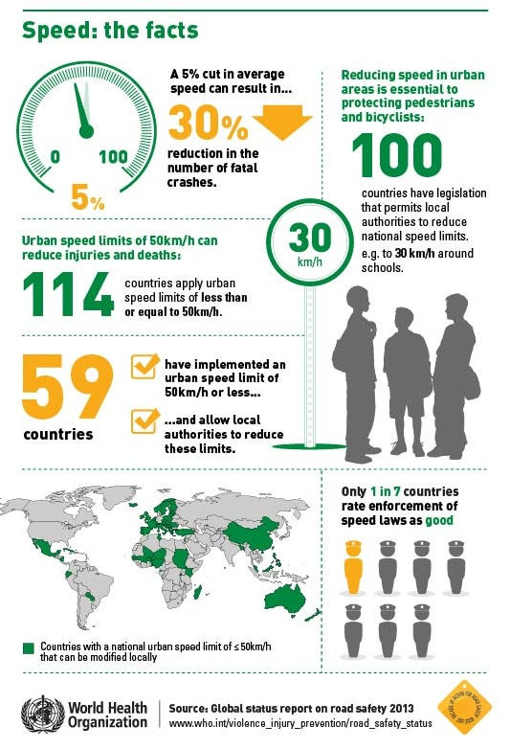
Speed
Notes:
This infographic looks at the importance of lower speed limits.
Driving at safe speeds, depending on the current road and weather conditions, is a vital part of any road safety policy. We should emphasise to our drivers that the speed limit is not a target, and that in many situations, such as on congested road, in poor weather, at night etc, it will not be safe to drive at the speed limit.

Slide 18
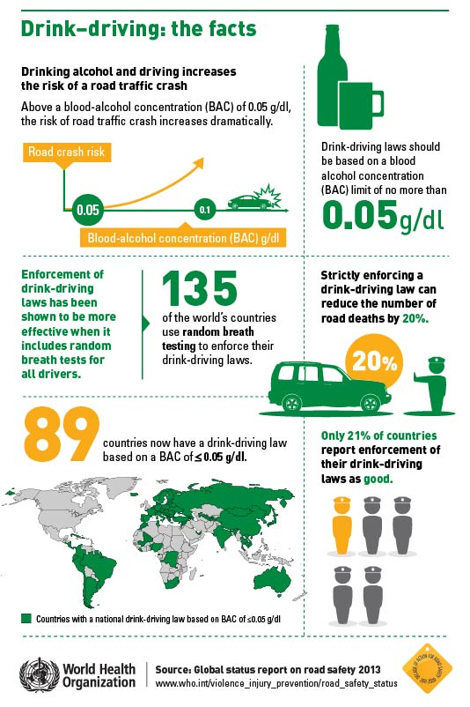
Impairment
Notes:
This infographic looks at the issue of drink driving globally. Any alcohol in the body, even below the local legal limit, will increase the risk of a collision occurring, so we should adopt a zero alcohol policy. We should also remind employees that they could still be impaired the morning after they have been consuming alcohol, and educate them as to how much alcohol they are consuming and how long it takes the body to metabolise that alcohol, so that they can work out when they will be alcohol free and therefore safe to drive.
We should also ensure that drivers do not have any drugs in their bodies when driving, as this will also increase the risk of a collision occurring. It is also important to remember that some medicines – both those prescribed by a doctor and those that can be purchased in a pharmacy – can increase the risk of being involved in a collision, so you need to ensure that employees are aware of this and that you prevent anyone driving under these circumstances.

Slide 19
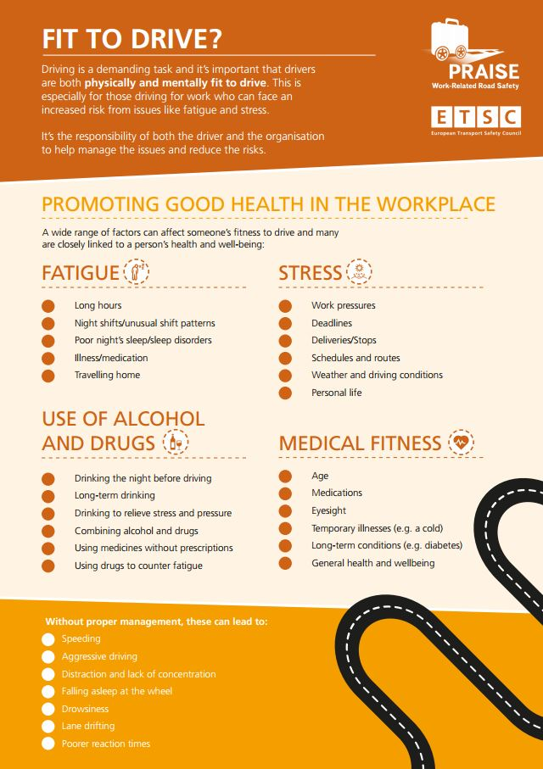
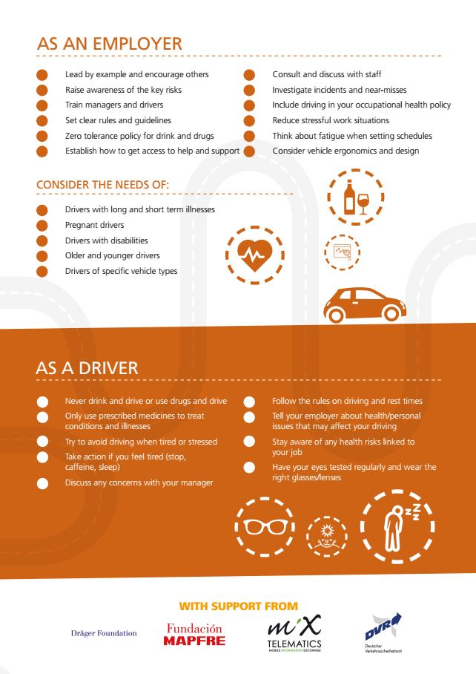
Notes:
This infographic looks at the wider issue of driver well-being, and provides some advice on what you can do, as managers, to promote wel-being.

Slide 20
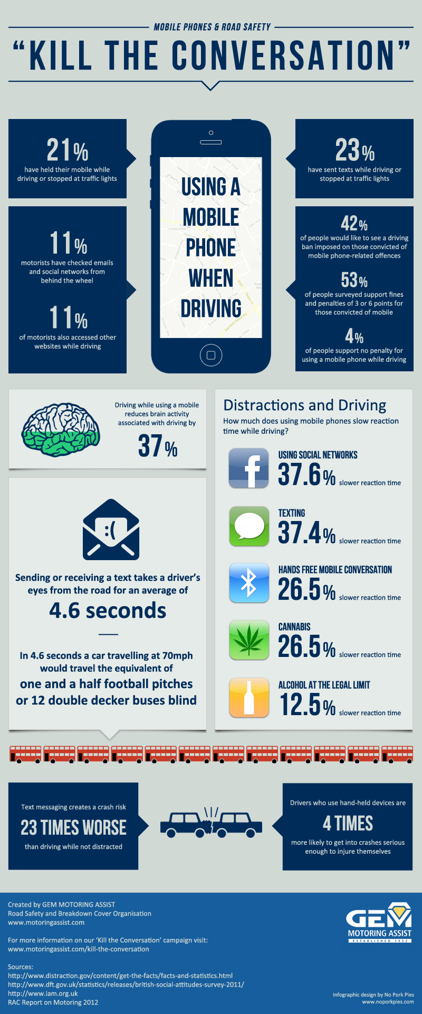
Distractions
Notes:
This infographic focuses on the biggest distraction – the use of phones / smartphones. Research from around the World has shown that drivers using a phone, whether this is hand held or hands-free, have a 4x risk of being involved in a crash.
You should raise awareness of the risks involved, and make sure that you do not encourage or endorse the use of phones when driving, and that you never call an employee when you know that they are driving, and if you do call at it is obvious that they are driving, end the call immediately.
Remember that there are many other distracting things that drivers do – talking to passengers, eating, drinking, personal grooming are some examples. You should ensure that the message you send to your drivers is very clear – when driving, their entire focus should be on safe driving and nothing else.

Slide 21
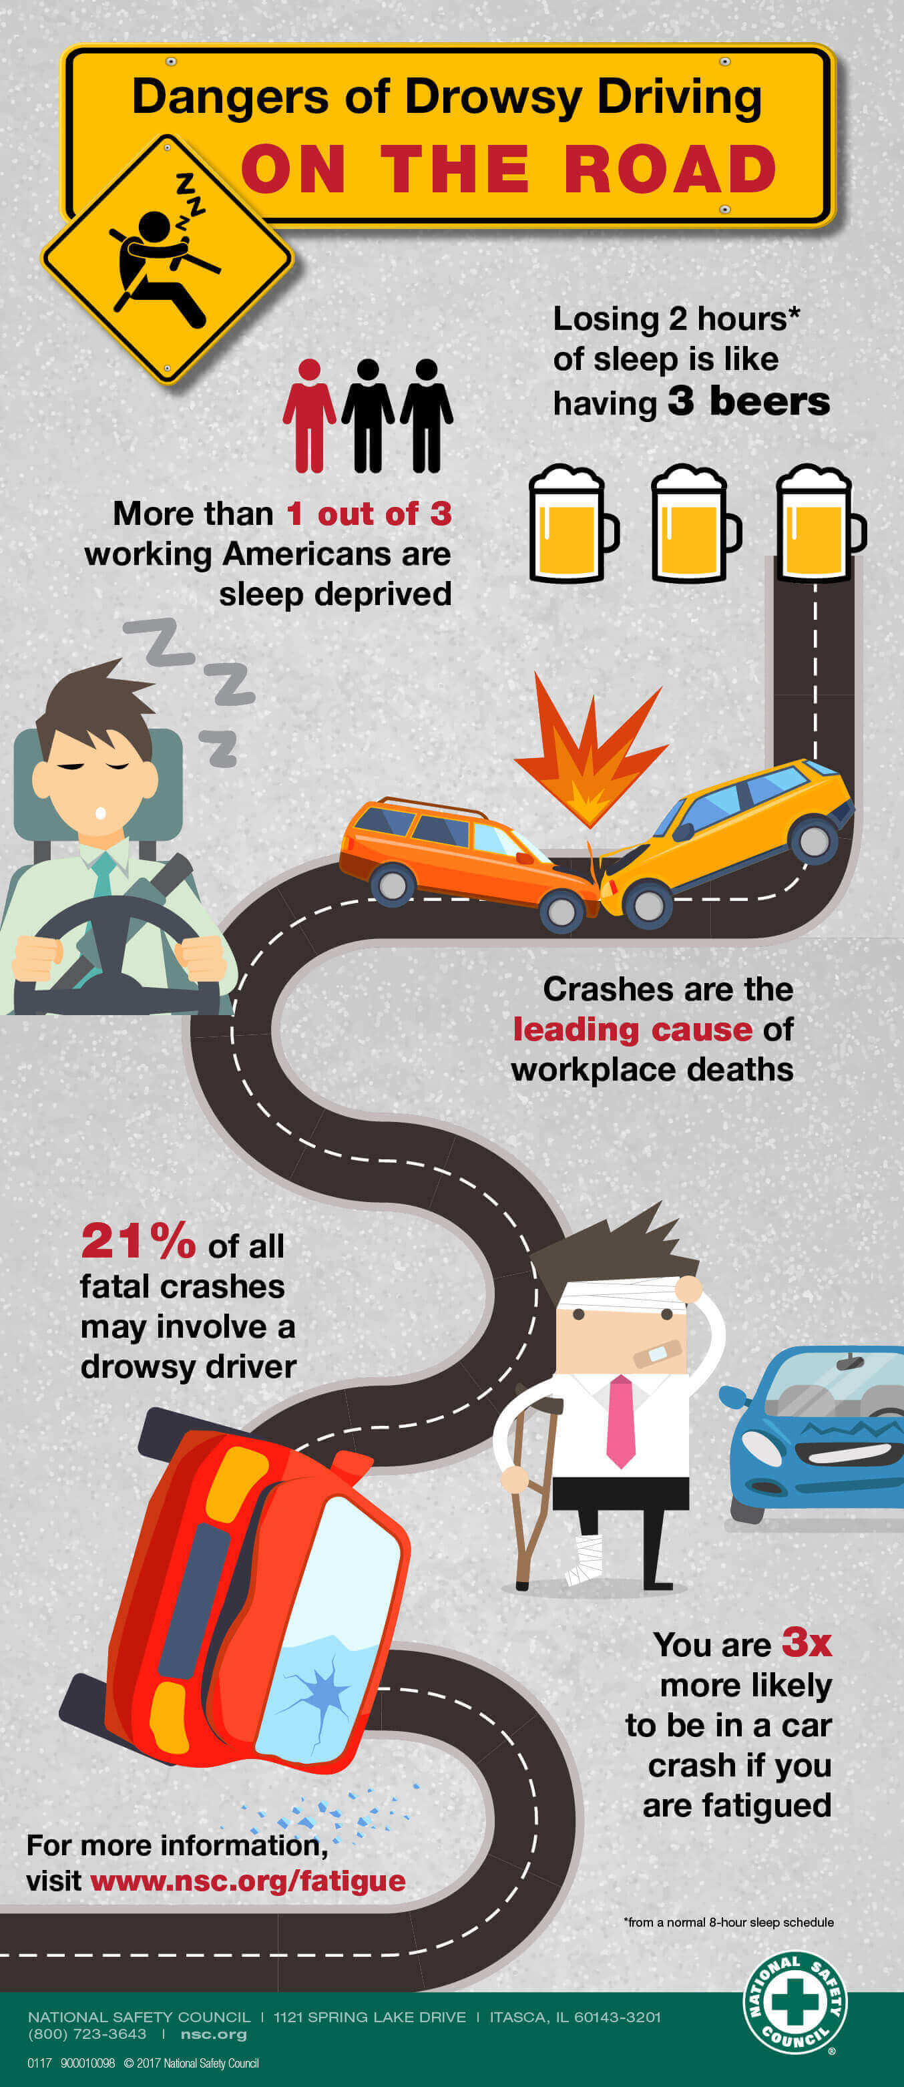
Fatigue
Notes:
This infographic looks at the risks associated with fatigue / driving when tired.
You need to ensure that you manage the total number of hours worked by your employees – this should include working time, driving time and commuting time.
You should also ensure that employees take regular breaks when driving – these should be every 2h, or sooner if the driver starts to feel tired, and the break should be around 15-20 minutes.
Fatigue is influenced by the duration and quality of sleep, so an employee’s personal circumstances will play a part here. If you notice any employee coming into work tired, then they should not be allowed to drive.

Slide 22
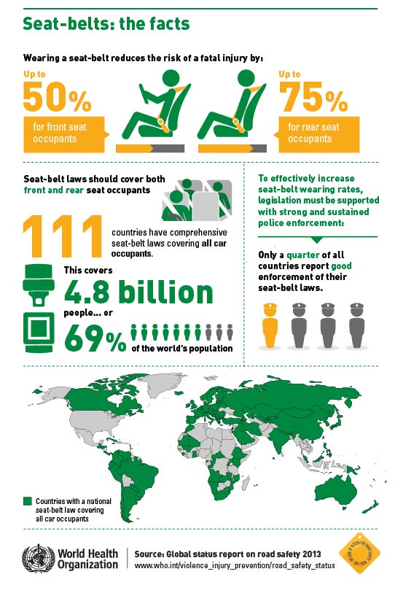
Seatbelts
Notes:
This infographic shows the benefits of wearing a seatbelt, and what the legislation and enforcement is like in different countries.
You should ensure that the vehicles that your employees are using have 3-point seatbelts fitted to all seats.
You should ensure that employees always wear their seatbelts, and that the driver ensures that everyone in the vehicle is wearing their seatbelt, regardless of any legal obligation to do so.

Slide 23
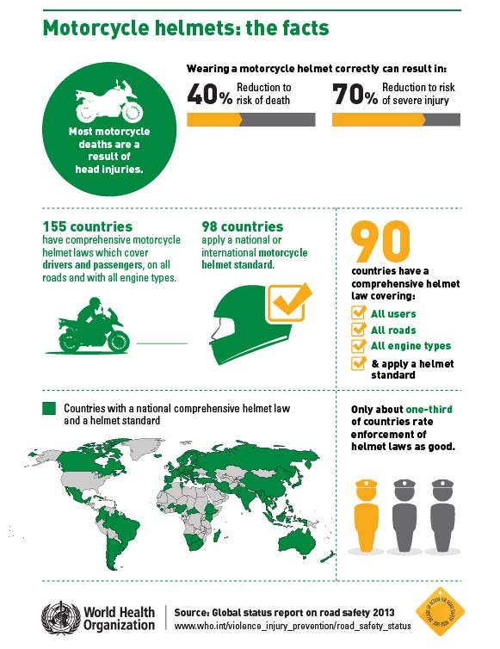
Helmets
Notes:
Only include this slide if you have employees using motorcycles / mopeds / scooters.
This infographic shows the benefit of wearing a helmet, and the legal situation around the World.
Regardless of the local laws in the countries where you are operating, you should ensure that employees always wear an approved helmet, and that this should always be fastened correctly.

Slide 24

Effective work-related road risk management
Notes:
Given the Company’s focus on safe driving, it is important to understand what an effective work-related road risk management program looks like, at a high level, so that you can understand where various initiatives fit in and what the overall strategy is.

Slide 25
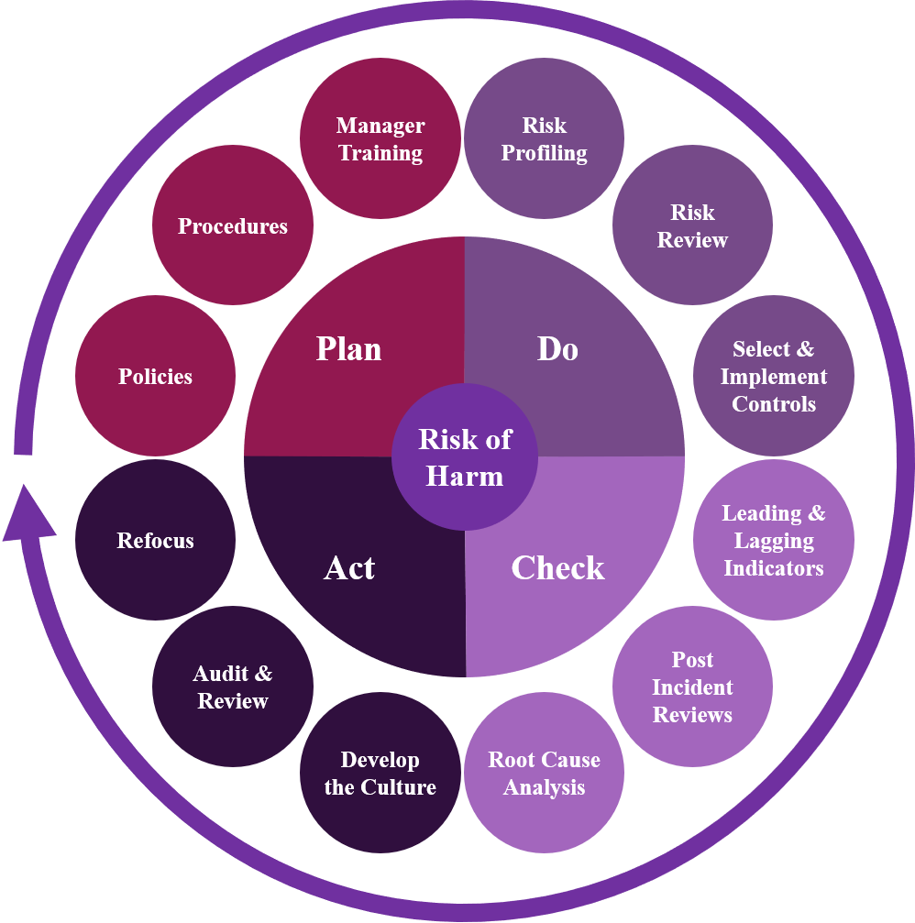
Notes:
This is what an effective work-related road risk management process looks like; it is based on the proven health & safety management process of Plan, Do, Check, Act.
You’ll notice that it is an on-going process. At first, you will address any identified high risk areas, but as you re-visit the process, you can check to see if your management program is effective, re-focus if necessary, and also take into account any emerging risks (e.g. changes in vehicle technology or legislation) and changes to your operations that will change the risks drivers face (e.g. relocating depots or offices, acquiring new businesses etc.).
It is beyond the scope of this training program to look into this process in depth, but some of the key elements would be the development of policies & procedures along with Line Manager training (this course!), the use of risk assessments to get an in-depth understanding of the risks faced, allowing the appropriate management and/or driver focused interventions to be implemented, what Key Performance Indicators to measure to see how successful the program is, understanding the underlying root causes of incidents and developing the on-road safety culture.

Slide 26

Line Manager Roles & Responsibilities
Notes:
This section looks at what your roles and responsibilities are in the Company’s road safety program.

Slide 27
Line Manager roles & responsibilities
Leadership
The controlling mind
  Real and perceived pressures
  Eliminating the need for employees to take risks whilst driving
Implementing safe driving policies and procedures
Getting the right safety-operational balance
Notes:
In the next few slides we will look at each of these topics in turn, so that you can understand your roles and responsibilities for safe driving and also how you can influence your employees to drive safely and follow the Company’s safe driving policies and procedures.

Slide 28
Leadership
Strong and effective leadership is critical for the success of your road safety initiative.
The senior leadership team, must provide the time, impetus and any necessary budget for your road safety program.
Remember that ALL managers are also leaders – you must be seen to be driving safely and following the safe driving policies and procedures.
Always be consistent with all employees…
Notes:
As with most aspects of business, leadership is critical for the success of any initiative.
When we talk about leaders, we often think of the senior leadership team, and of course they are important to provide the time, impetus and any necessary budget for your road safety program.
But all managers are also leaders, and it is important that everyone – from the senior leadership team to all of you, are seen to be driving safely and following the safe driving policies and procedures. If you have one set of rules for your employees and one set of rules for leaders and managers, there is little chance that drivers will think that you are taking safe driving seriously…
You also need to be consistent – all employees must be subject to the same rules and procedures, regardless of how valuable they are to the business. It is no use saying that you will overlook one employee’s bad driving as they are so good at their job – this will send out a negative message to his or her colleagues…

Slide 29
The controlling mind
You have a big influence over how employees behave when driving
“What interests my manager, interests me”
The importance of giving consistent messages out so that employees really understand the importance of safe driving and how that fits in with their other objectives.
Notes:
What do we mean by ‘the controlling mind’?
An employee’s manager has a big influence over how they behave; the saying, “What interests my manager, interests me” sums this up nicely. As such, if the message we give to our employees is that they should follow the safe driving policies and procedures BUT it is more important to hit operational targets, then how will the employees drive if they are faced with a choice? They are likely to take risks to achieve the operational metric.
Given that managers and supervisors have so much influence over their direct reports, whether they realise this or not, it is critically important that you always drive safely and give consistent messages out so that employees really understand the importance of safe driving and how that fits in with their other objectives.

Slide 30
Implementing safe driving policies and procedures
You must implement the safe driving policies and procedures.
You must ensure that your employees understand them and are following them.
Notes:
Line Managers and Supervisors are also responsible for actually implementing the safe driving policies and procedures. These will have probably been written by someone else, but you need to take ownership of them and, critically, ensure that your employees understand them and are following them.

Slide 31
Getting the right safety-operational balance
What risks will the business tolerate? Based on this, you determine what risks you will allow employees to take to achieve a business goal, and which are unacceptable and subject to strict management controls.
There is no right or wrong answer here – it depends on where, as an organisation, the priority for safe driving is.
Often you will need to change operational procedures and practices to allow employees to drive safely…
Notes:
This is probably the biggest issue, and is linked to the controlling mind. You need to understand what risks the business will tolerate, and in that environment, you can determine what the safety-operational balance is; that is, what risks you allow employees to take to achieve a business goal, and which are unacceptable and subject to strict management controls.
There is no right or wrong answer here – it depends on where, as an organisation, the priority for safe driving is, and what operational changes you are willing to make to allow employees to drive safely (e.g. having employees work shorter hours to help manage fatigue when driving).

Slide 32
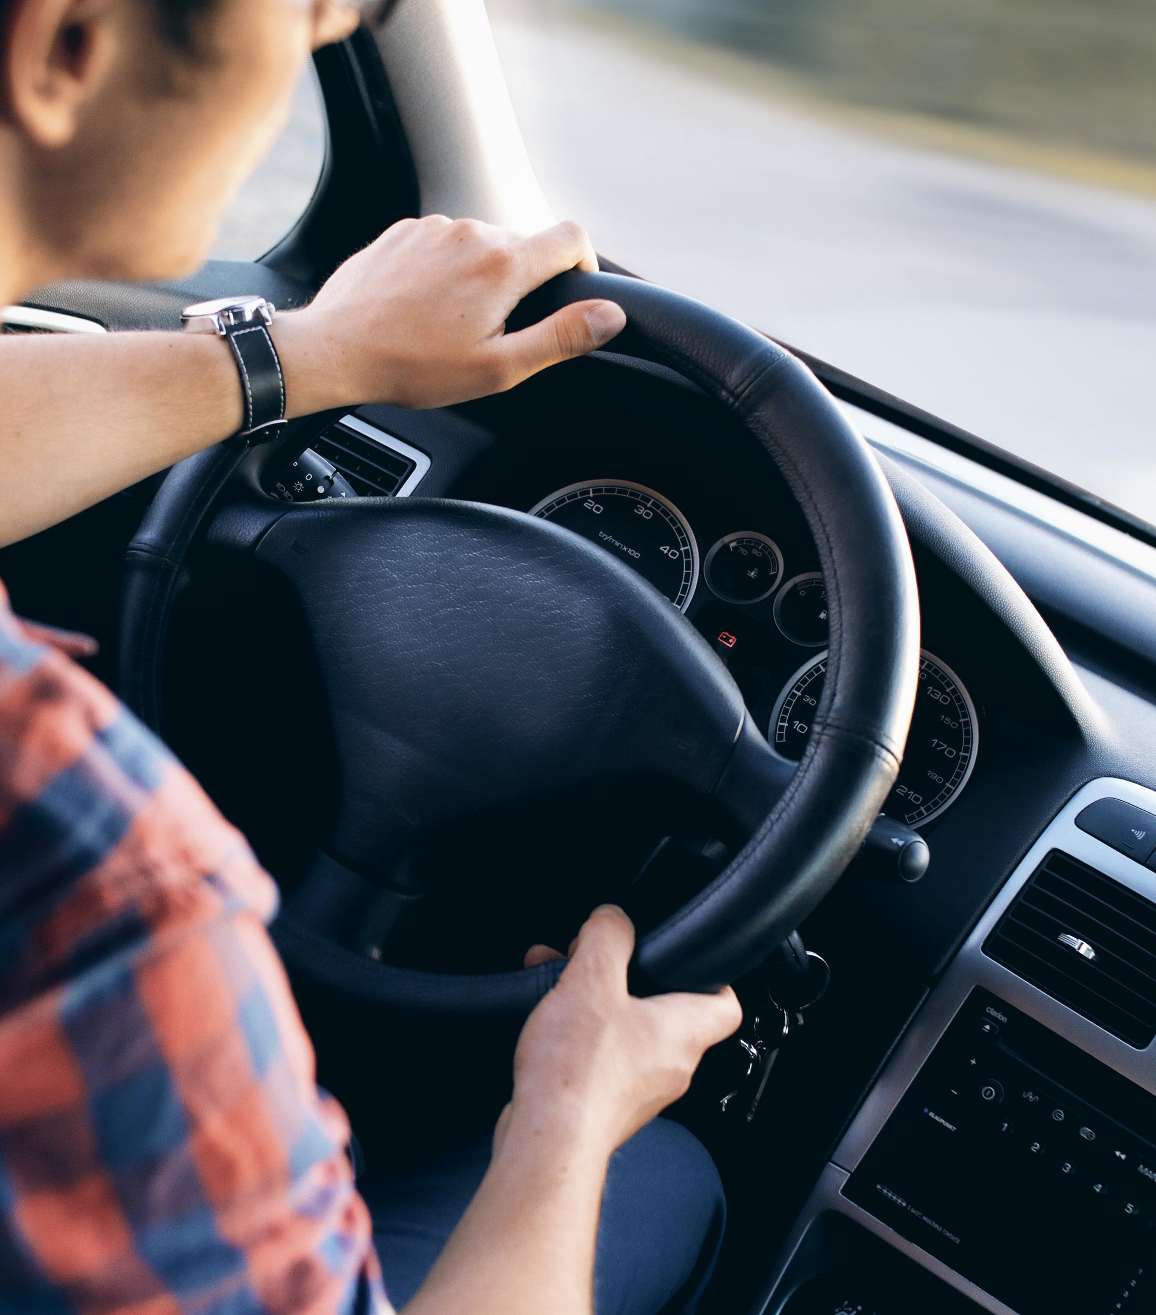
Engaging with drivers
Notes:
Given that Line Managers and Supervisors have such an important role to play in the success of the Company’s road safety program, it is important to be able to effectively engage with your drivers, as part of your regular contact with your employees.

Slide 33
Engaging with drivers
Driving is a very emotive issue!
Need to use neutral language / don’t use a ‘blame’ approach
Use facts
Ride-alongs
Leadership – being seen to follow all safe driving policies & procedures and always being seen to drive safely
  Don’t call drivers when you know they will be driving!
Consider more in-depth classroom training over and above this resource…
Notes:
The first thing to say is that driving is a very emotive issue – most people tend to over-estimate the standard of their driving, and it is difficult to criticise them!
This is where the language you use is important. Don’t talk about who was at fault for the collision but instead discuss what the driver could have done to prevent the collision from occurring, regardless of which road user made an error.
Wherever possible, use data as the basis for your conversations. This could be collision reports, driver behaviour telemetry or any other reliable source of data – it is difficult for a driver to argue with undisputed facts.
Try and spend time with employees when they are driving, to experience for yourself how they drive.
As already mentioned, make sure that you are always seen to be driving safely, and don’t enable drivers to take risks, such as calling them when you know they will be driving.
This is an important issue, so consider some more in-depth training on this.

Slide 34
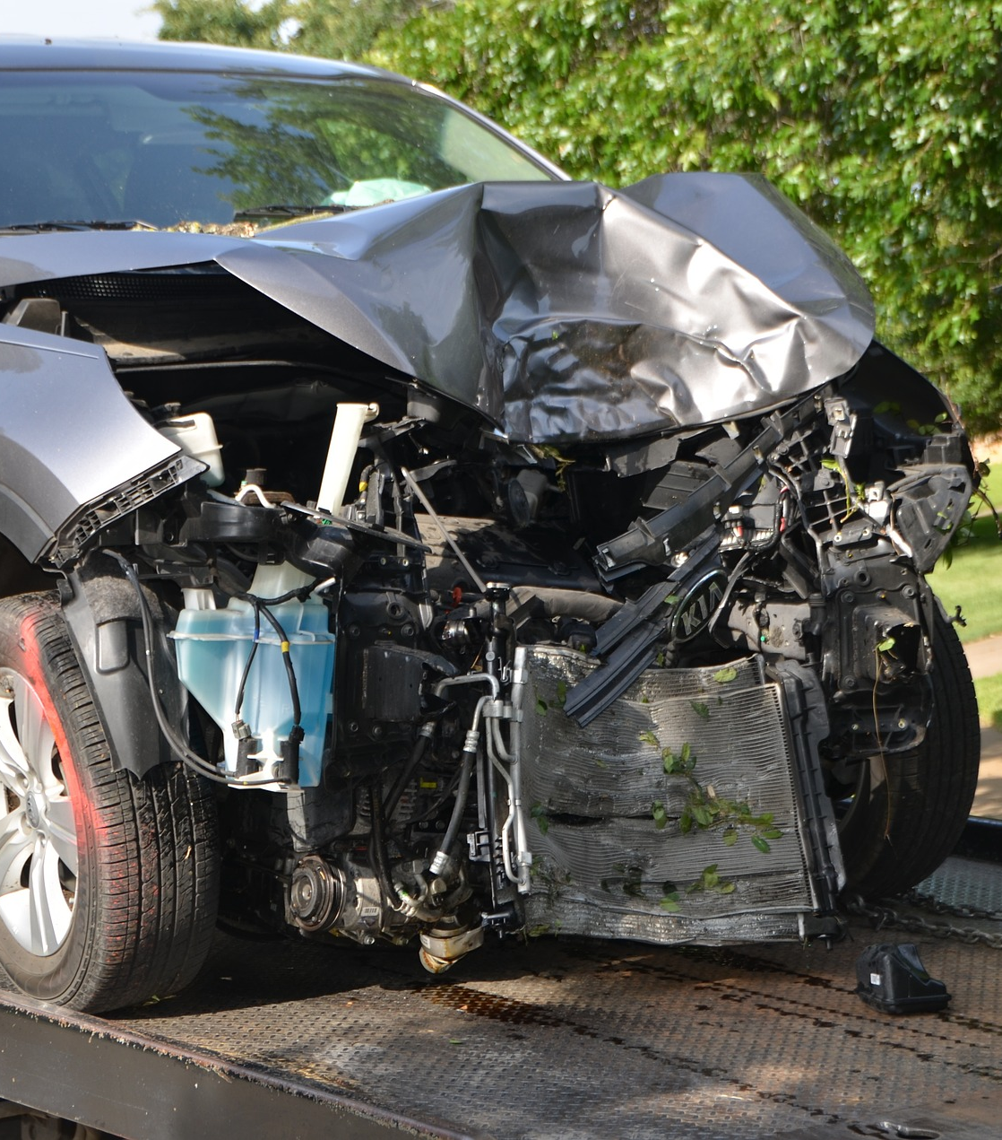
Post-Incident Debriefs
Notes:
We’re going to look at what you can do when a collision or incident has occurred.
This is one of the most important tasks for a Line Manager / Supervisor, to understand what the underlying root causes are of the collision.

Slide 35
Post-incident debriefs
Vital part of any effective work-related road risk management process
Needed to determine the underlying root cause or causes of the incident
Use a post-incident review tool to help with the debrief
Determine the appropriate management and/or driver-focused interventions, to help prevent reoccurrence of the incident
Additional classroom training over and above this resource may be required…
Notes:
You should talk to the driver, using neutral language and any facts about the incident, to understand what happened and to try and determine the underlying root causes. It is always important to ask yourself:
What have we done, as an organisation and/or management team, that may have contributed to the collision occurring?
This is a difficult question to consider but a powerful one – the crash may have been caused by bad driving, but it is equally likely that the behaviours exhibited by the driver in the run-up to the crash were due to some operational requirements or business objectives. Use the post-incident tool to help you with these debriefs.
Choose the appropriate intervention, based on what underlying root cause you determined, to help prevent reoccurrence. Remember that this is just as likely to be a management intervention as one focused on the individual driver…
This is another area where additional training will help ensure that you can carry out post-incident debriefs effectively.

