Slide 1
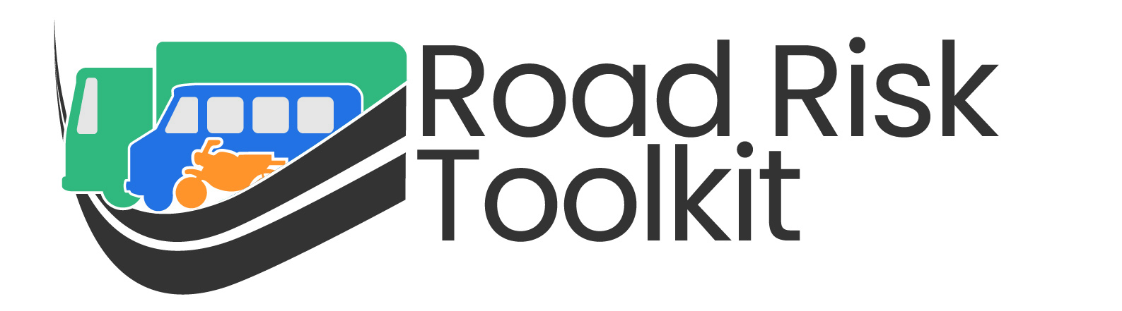
Шаблон Презентации
Подготовка для Непосредственного Руководителя
Данная презентация является шаблоном для обучения непосредственных руководителей безопасности дорожного движения
Вы можете её использовать не добавляя ничего нового
Тем не менее, будет лучше если вы добавите больше информации чтобы сделать её более актуальной именно для вашей компании
Вы можете добавить изображения показывающие местные дорожные заторы и.т.д
Вы также можете добавить слайды, объясняющие внутренние правила вашей компании
Для бесплатных модулей электронного обучения, посетите https://roadrisktoolkit.com/
За советом по дальнейшему обучению, обращайтесь к: mail@roadrisktoolkit.com

Slide 2


Обучение непосредственного руководителя

Slide 3
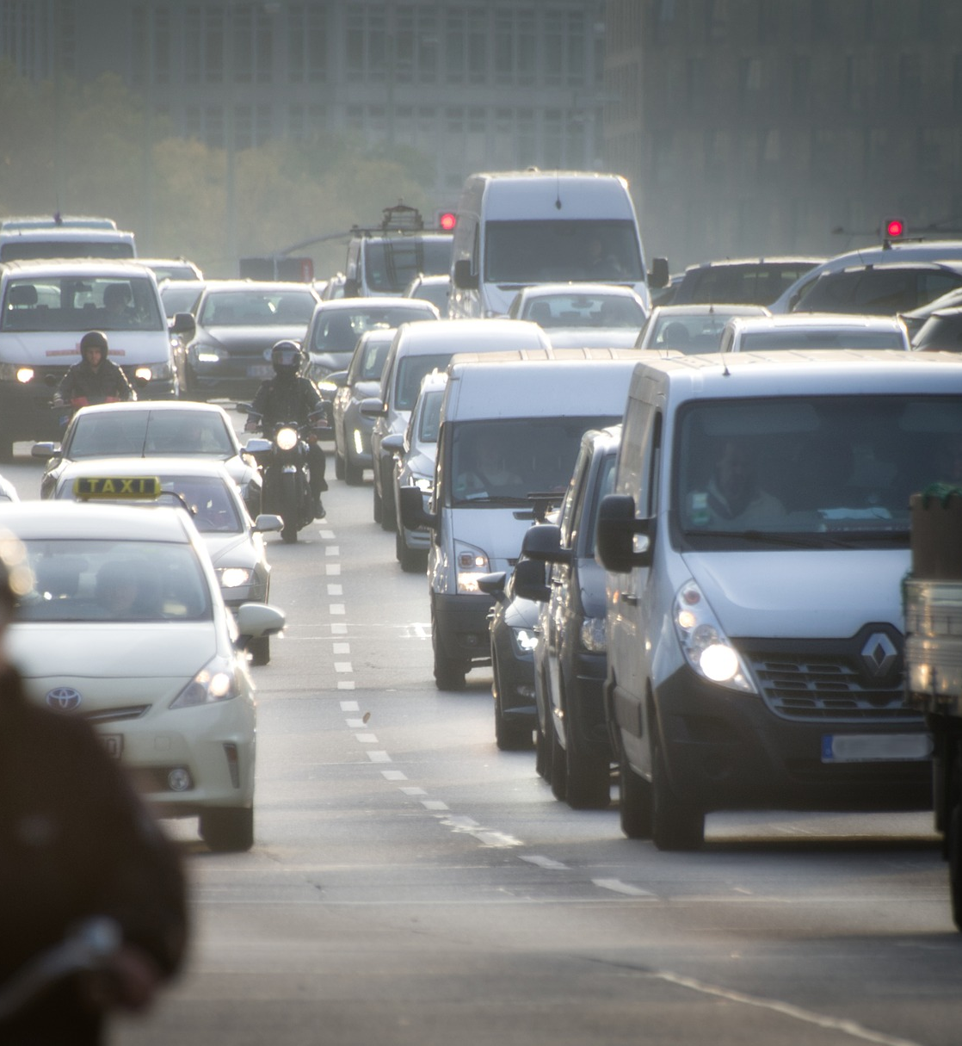
Повестка дня
Масштаб проблемы
Зачем управлять дорожными рисками связанными с работой?
Самые большие риски
Эффективное управление дорожными рисками
Роли и обязанности непосредственного руководителя
Взаимодействие с водителями
Опросы после происшествия

Slide 4
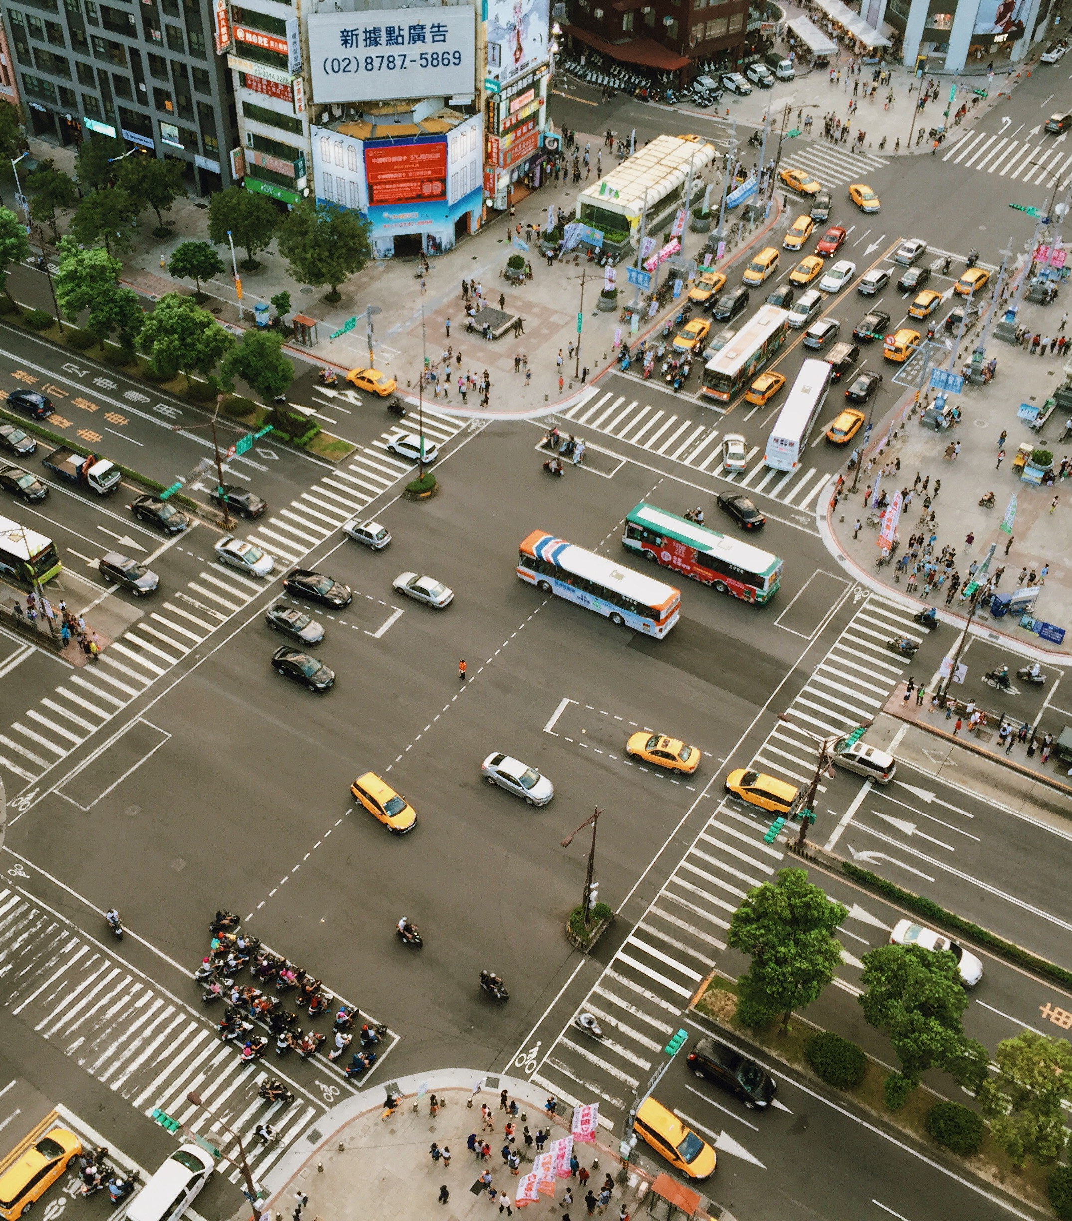
Масштаб проблемы
Notes:
This section of the presentation looks at the scale of the road safety problem around the World.

Slide 5
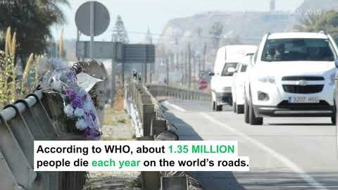
Notes:
Video introduction highlighting the true scale of the road safety problem around the World.
It highlights some facts and figures and talks about the Sustainable Development Goals as a framework for Governments to use to help improve road safety.

Slide 6
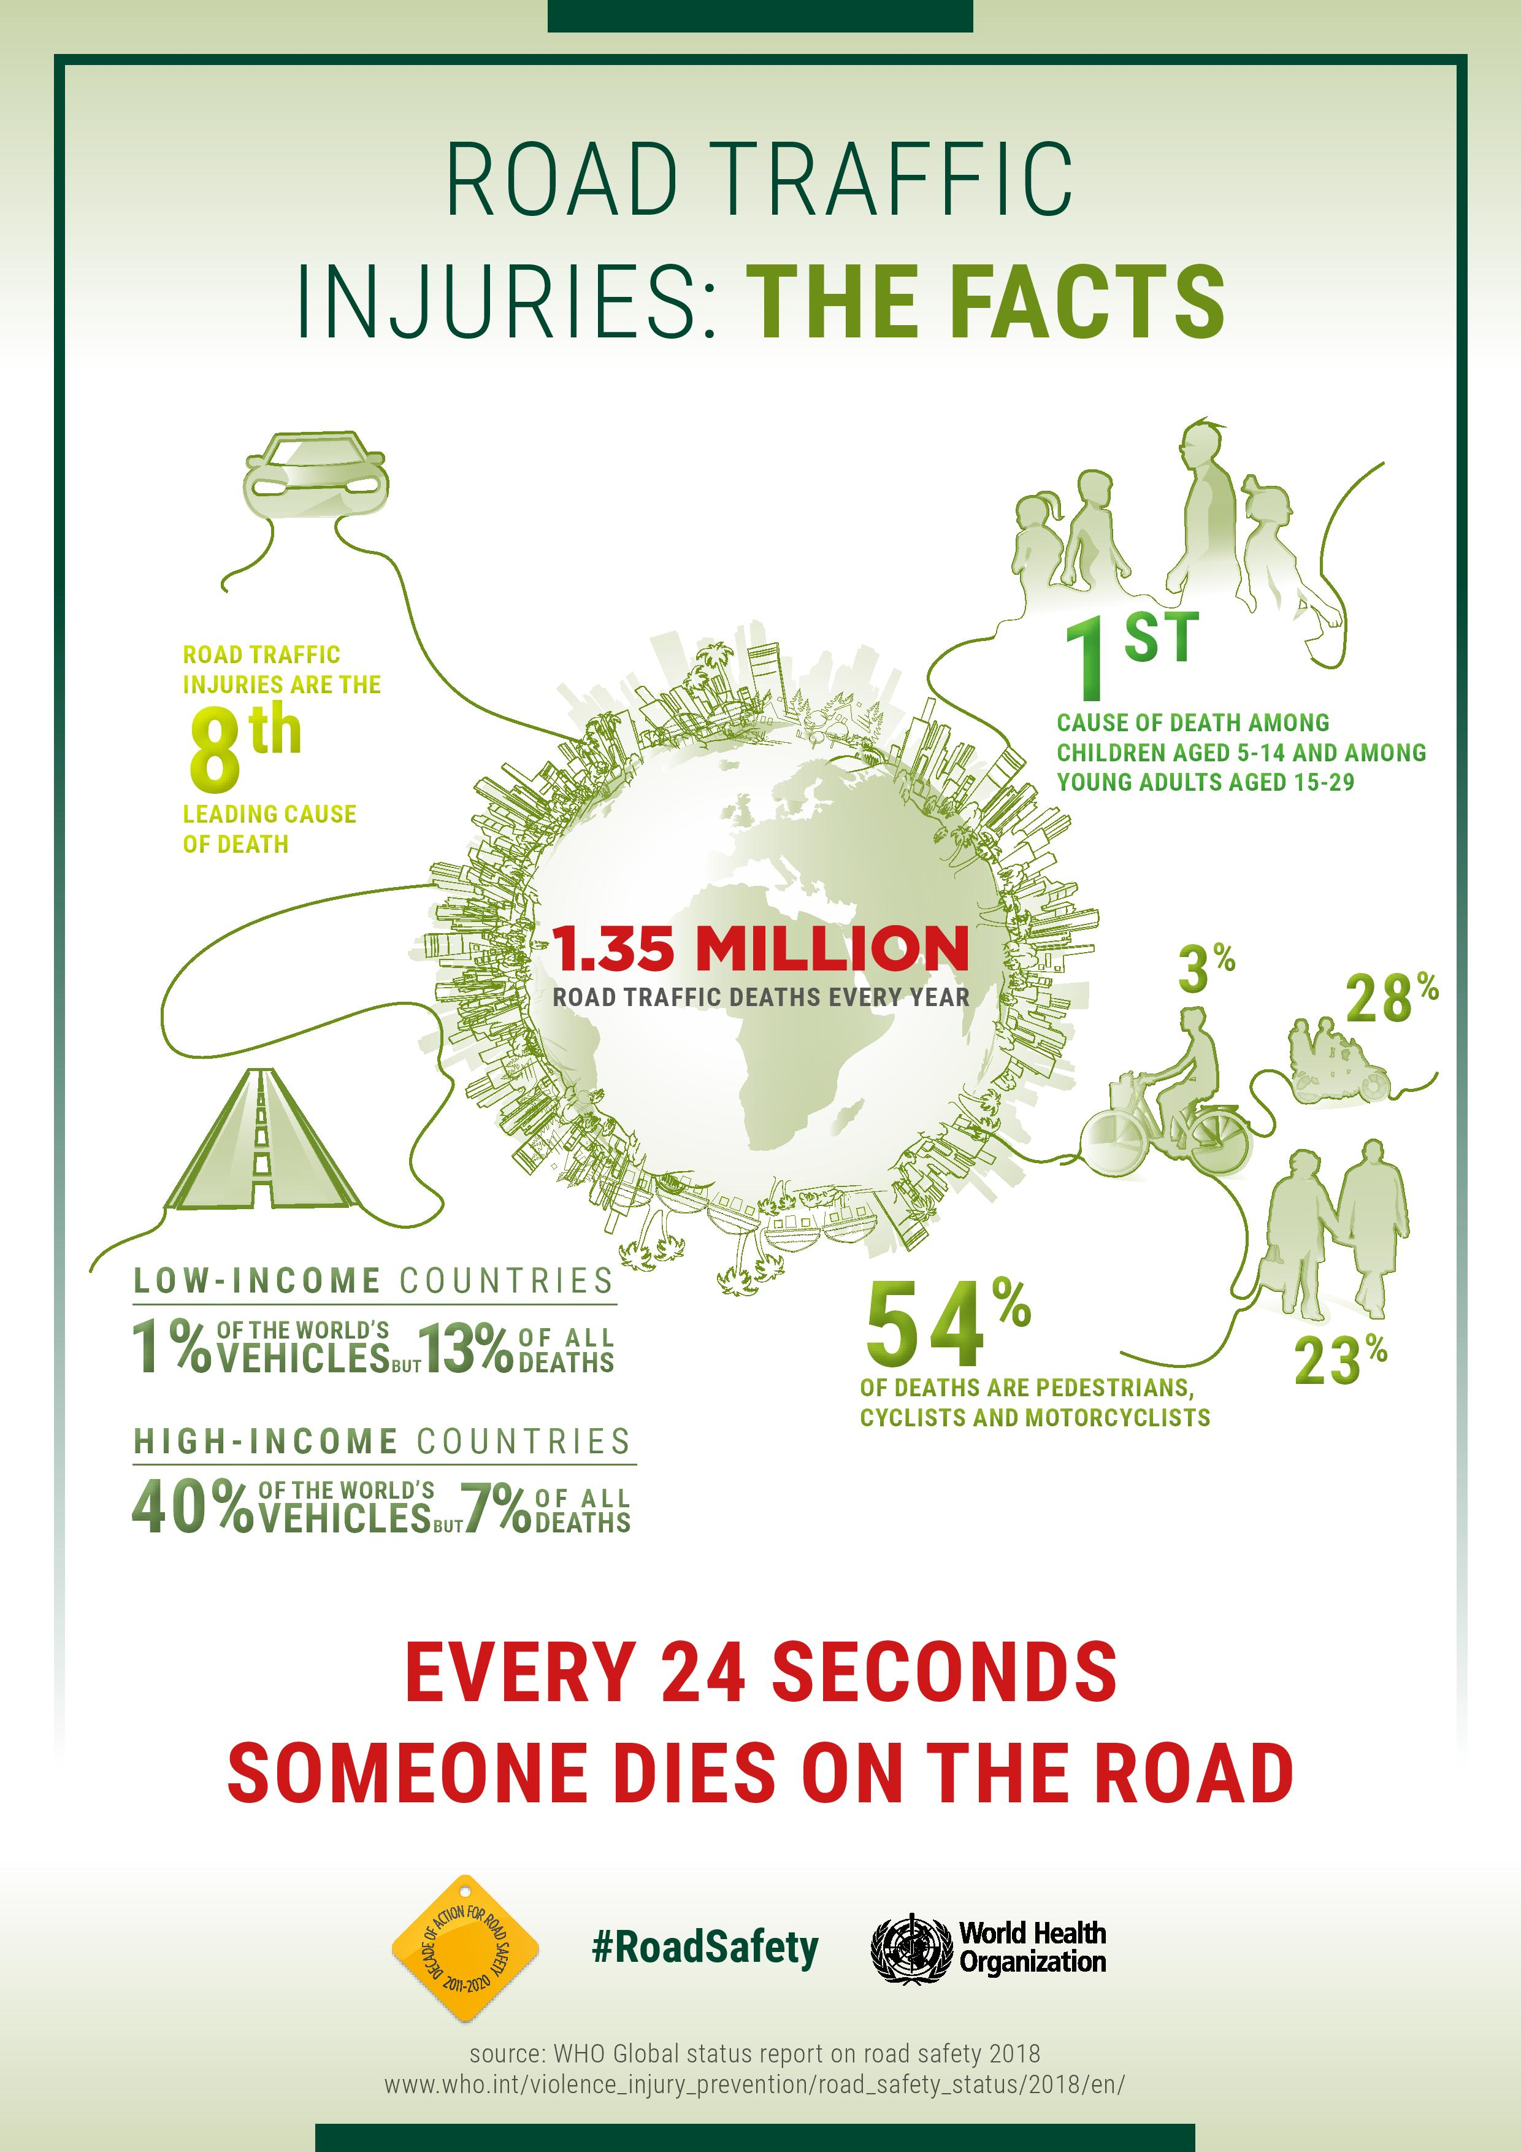
Notes:
This infographic backs up some of the information in the video and highlights where the scale of the problem in terms of Low and Middle Income countries and also the issue with vulnerable road users – pedestrians, motorcyclists and cyclists.
You should always remember that our responsibilities as Managers is to manage the health & safety of our employees AND those who they share the road with, so we should treat any collision where there have been injuries (or the potential for injuries) to any road users as seriously as where one of our employees has been injured (or the collision could have resulted in an injury).

Slide 7
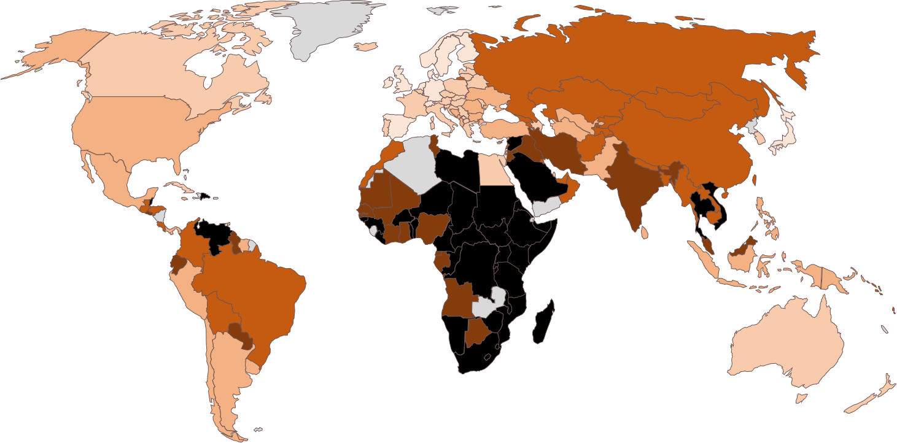
Тепловая карта фатальных дорожно-транспортных происшествий
Notes:
This heat map of where road fatalities occur – the darker the colour, the higher the number of fatalities per 100,000 population – helps you see where the problems lie in the countries where you are operating.

Slide 8

Зачем управлять дорожными рисками связанными с работой?
Notes:
This section looks at the reasons why the Company should manage work-related road risks.
If this is being run as an interactive session, ask the reasons why here.

Slide 9
Зачем управлять дорожными рисками связанными с работой?
Риск причинения вреда
Риск судебного преследования
Корпоративные социальные обязанности
Финансовые потери
Notes:
These are the fundamental reasons why any organisation should manage work-related road risks.
The next few slides look into each area in a little more depth, to provide you with insights that you can use within your business.

Slide 10
Риск Причинения Вреда
Каждый год, 1.35 миллиона людей погибают в дорожно-транспортных происшествиях
  93% из них в странах с низким и средним уровнем дохода
  52% погибших являются уязвимыми участниками дорожного движения (пешеходы, велосипедисты и мотоциклисты)
  Перейдите по этой ссылке, чтобы увидеть число погибших на 100 000 человек в странах, где вы работаете:
  https://www.grsproadsafety.org/resources/global-crash-data/
Исследования водителей на работе, показывают что они подвергаются повышенному риску вовлечения в аварию
Notes:
Remind everyone of the facts and figures that were covered earlier.
Use the link to lookup the fatality rates in the countries where you operate, to see the scale of the problem locally.
At work drivers have more crashes that private motorists, even after their higher mileages are accounted for. This may be down to the increased pressures they face from work-related activities, on top of whatever they are experiencing in their private lives.
You should also point out that it is not just road fatalities that should be of concern – it’s the millions of serious injuries too.

Slide 11
Риск судебного преследования
Не только водитель может нести ответственность за столкновение. В зависимости от того, в какой стране вы работаете, управленческая команда может нести ответственность, если выяснится что она косвенно причастна к аварии, например из-за халатности или необоснованных требований к водителю.
Notes:
The legal situation will vary by country, so it is not worth going into depth here, but just saying that there is a risk of prosecution if any management failings are seen by the authorities to have contributed to the collision occurring.

Slide 12
Корпоративные Социальные Обязанности
Не причинять вреда работникам или представителям общественности которые разделяют с ними дорогу
  Напоминание о том что, в случае ранения третьего лица могут возникнуть негативные последствия для компании а так же психологическая травма водителя
  Быть хорошими соседями в офисах и на площадках
  Взаимодействие между безопасностью и окружающей средой
Notes:
From the discussions previous about the number of fatalities and serious injuries, and the risks involved, it is clear that any organisation taking its Corporate Social Responsibilities seriously should be managing work-related road safety effectively.
Always remember that managing work-related road safety is not just about keeping your employees safe – it is about protecting members of the public who you share the road with. We’ve heard that 54% of fatalities involve vulnerable road users – pedestrians, cyclists and motorcyclists.
There are many things that are good for managing road safety that are also good for the environment, so effective work-related road risk management will help with your ‘green’ initiatives.

Slide 13
Финансовые проблемы
Каждая авария понесёт за собой:
  Прямые потери, такие как:
    Убыток от поданных заявлений о страховом возмещении
    Затраты на ремонт. если они не покрыты страховкой
    Расходы на аренду заменяемых транспортных средств и.т.д
  Косвенные или скрытые расходы / незастрахованные убытки
Notes:
While preventing crashes to prevent fatalities and serious injuries should be the biggest motivator, safe driving also makes good business sense.
The direct costs will depend on the nature of your insurance policy, but might include the things listed.
If you are running an interactive session, ask what the hidden costs / uninsured losses are?

Slide 14
Незастрахованные убытки
Международный институт контроля над убытками сообщает, что на каждые $1/ £1 / €, выплаченные страховщиком, страховые убытки составляют 8-53 $/ £ / € , в зависимости от серьёзности происшествия. Найдите минуту чтобы подумать о там, как это выглядит, основываясь на вашем опыте!
Но каковы эти скрытые расходы? Это будет зависеть от характера вашей организации, но всегда будет включать невыход на работу - сотрудник не будет делать то, за что вы ему платите, и из-за этого будут финансовые последствия. Даже если ваш сотрудник не пострадал в аварии, вы не должны недооценивать психологическое воздействие от увиденного (если кто-то убит или серьёзно ранен в аварии) – его продуктивность снизится на некоторое время
Конечно, существует множество других скрытых затрат - снижение производительности, несвоевременные поставки, нарушение соглашений об уровне обслуживания, увеличение текучести кадров - этот список можно продолжать и продолжать. Вы не должны забывать о скрытых расходах, связанных с ущербом причинённым вашей репутации если СМИ будут ассоциировать вашу компанию с аварией - какой ущерб это может нанести вашему бизнесу?
Notes:
This should provide an insight into the true costs to the business every time a collision occurs.

Slide 15

Самые Большие Риски
Notes:
This section looks at what the biggest risks are, in terms of the chances that an employee or someone that they share the road with will be killed or seriously injured in a road crash.
If this Line Manager training is being run as an interactive session, then at this point ask the question:
“What are the main reasons why serious collisions occur?”

Slide 16
Самые большие риски
Скорость
Вождение под влиянием
Отвлечение
Усталость
Ремень безопасности и шлемы
Notes:
These are the main reasons why collisions involving someone being killed or seriously injured occur.
There are, of course, other reasons, such as travelling too close to the vehicle in front, unsafe overtaking etc. but these often have underlying contributory factors such as fatigue, distraction etc.

Slide 17
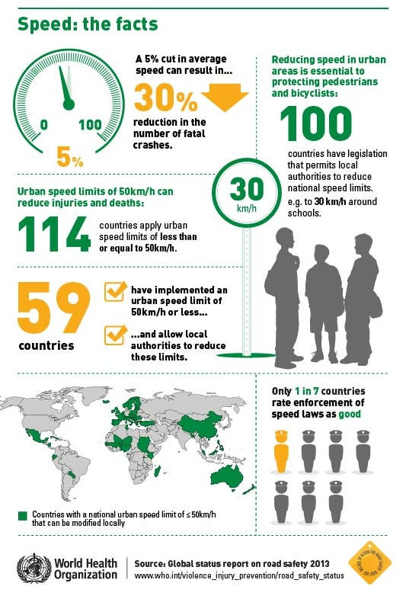
Скорость
Notes:
This infographic looks at the importance of lower speed limits.
Driving at safe speeds, depending on the current road and weather conditions, is a vital part of any road safety policy. We should emphasise to our drivers that the speed limit is not a target, and that in many situations, such as on congested road, in poor weather, at night etc, it will not be safe to drive at the speed limit.

Slide 18
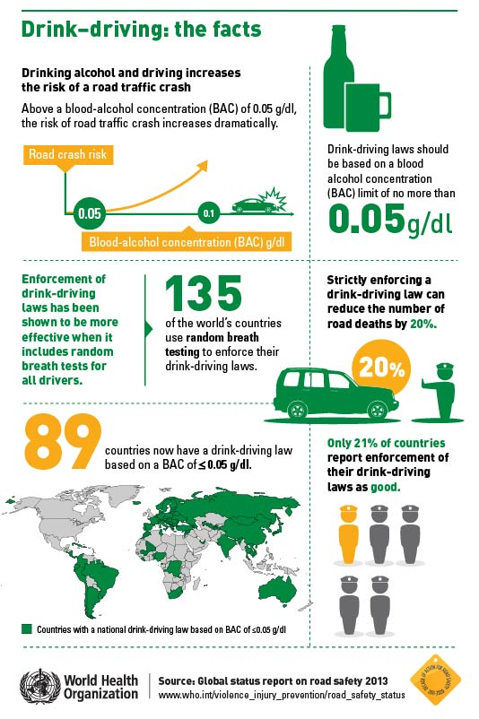
Вождение под влиянием
Notes:
This infographic looks at the issue of drink driving globally. Any alcohol in the body, even below the local legal limit, will increase the risk of a collision occurring, so we should adopt a zero alcohol policy. We should also remind employees that they could still be impaired the morning after they have been consuming alcohol, and educate them as to how much alcohol they are consuming and how long it takes the body to metabolise that alcohol, so that they can work out when they will be alcohol free and therefore safe to drive.
We should also ensure that drivers do not have any drugs in their bodies when driving, as this will also increase the risk of a collision occurring. It is also important to remember that some medicines – both those prescribed by a doctor and those that can be purchased in a pharmacy – can increase the risk of being involved in a collision, so you need to ensure that employees are aware of this and that you prevent anyone driving under these circumstances.

Slide 19
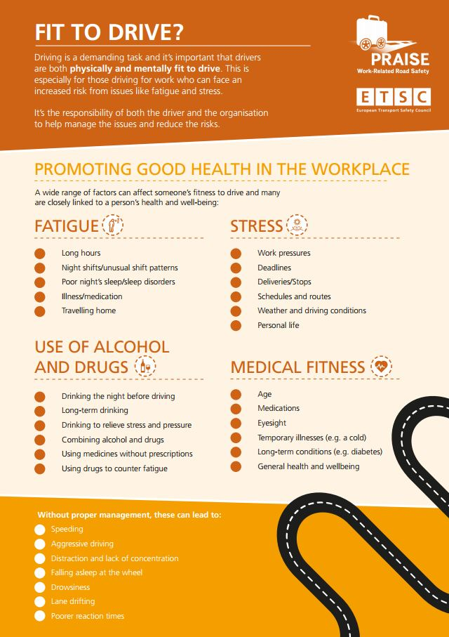
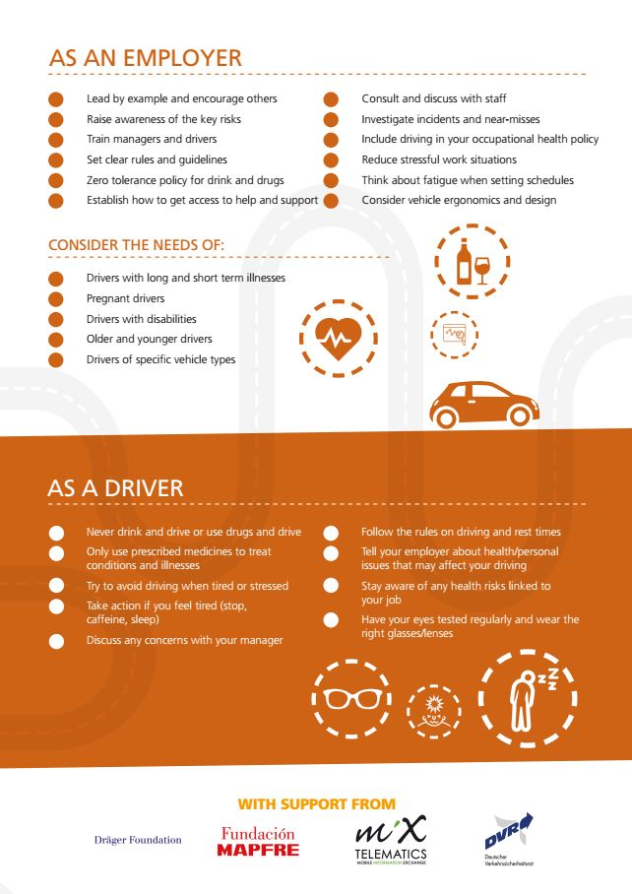
Notes:
This infographic looks at the wider issue of driver well-being, and provides some advice on what you can do, as managers, to promote wel-being.

Slide 20
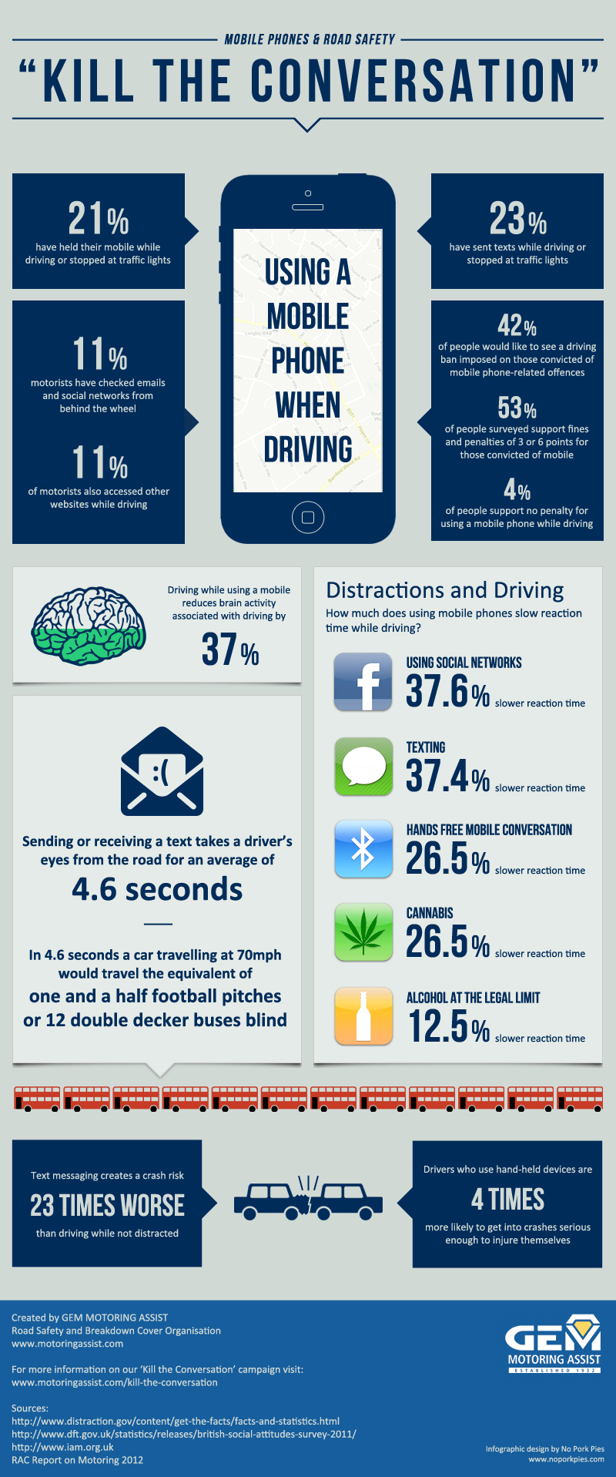
Отвлечения
Notes:
This infographic focuses on the biggest distraction – the use of phones / smartphones. Research from around the World has shown that drivers using a phone, whether this is hand held or hands-free, have a 4x risk of being involved in a crash.
You should raise awareness of the risks involved, and make sure that you do not encourage or endorse the use of phones when driving, and that you never call an employee when you know that they are driving, and if you do call at it is obvious that they are driving, end the call immediately.
Remember that there are many other distracting things that drivers do – talking to passengers, eating, drinking, personal grooming are some examples. You should ensure that the message you send to your drivers is very clear – when driving, their entire focus should be on safe driving and nothing else.

Slide 21
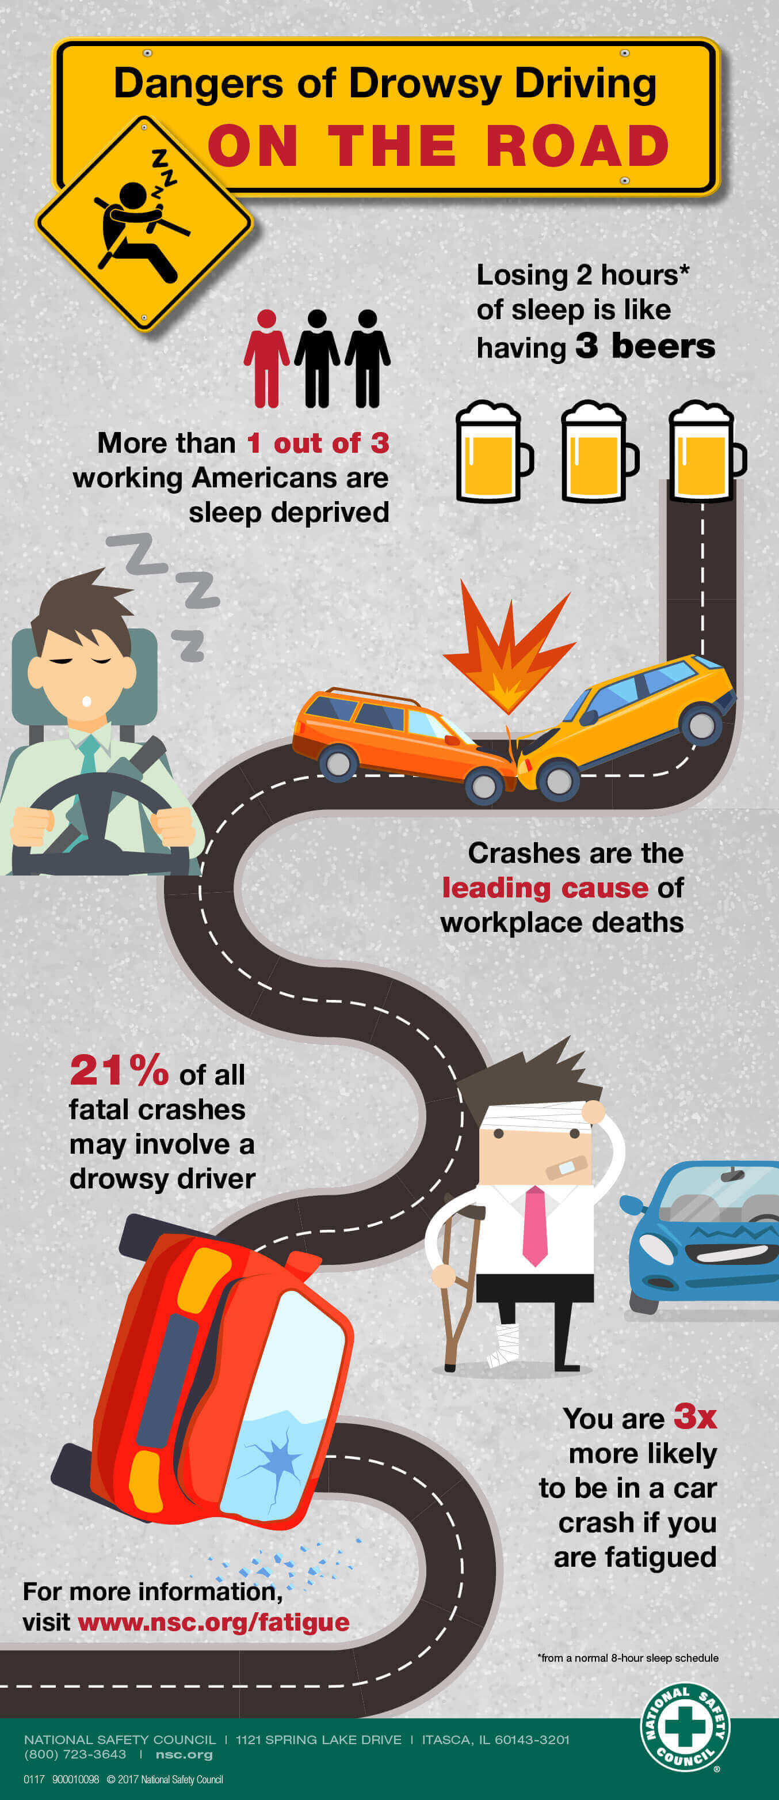
Усталость
Notes:
This infographic looks at the risks associated with fatigue / driving when tired.
You need to ensure that you manage the total number of hours worked by your employees – this should include working time, driving time and commuting time.
You should also ensure that employees take regular breaks when driving – these should be every 2h, or sooner if the driver starts to feel tired, and the break should be around 15-20 minutes.
Fatigue is influenced by the duration and quality of sleep, so an employee’s personal circumstances will play a part here. If you notice any employee coming into work tired, then they should not be allowed to drive.

Slide 22
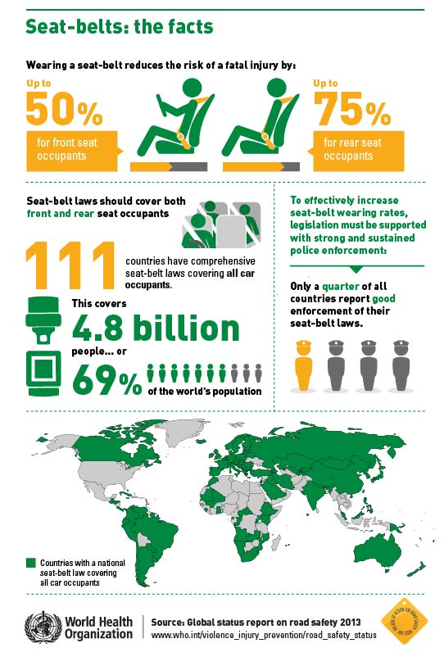
Ремень безопасности
Notes:
This infographic shows the benefits of wearing a seatbelt, and what the legislation and enforcement is like in different countries.
You should ensure that the vehicles that your employees are using have 3-point seatbelts fitted to all seats.
You should ensure that employees always wear their seatbelts, and that the driver ensures that everyone in the vehicle is wearing their seatbelt, regardless of any legal obligation to do so.

Slide 23
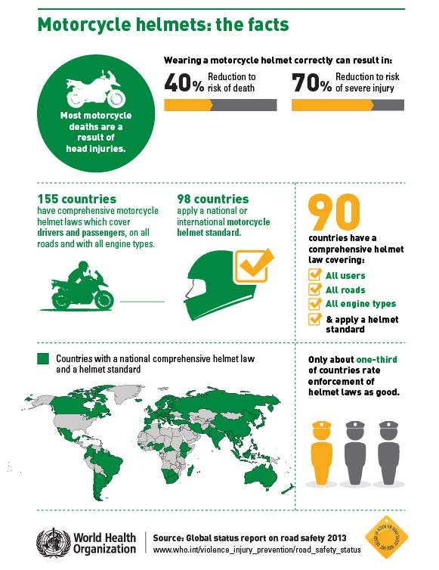
Шлемы
Notes:
Only include this slide if you have employees using motorcycles / mopeds / scooters.
This infographic shows the benefit of wearing a helmet, and the legal situation around the World.
Regardless of the local laws in the countries where you are operating, you should ensure that employees always wear an approved helmet, and that this should always be fastened correctly.

Slide 24

Эффективное управление дорожными рисками, связанное с работой
Notes:
Given the Company’s focus on safe driving, it is important to understand what an effective work-related road risk management program looks like, at a high level, so that you can understand where various initiatives fit in and what the overall strategy is.

Slide 25
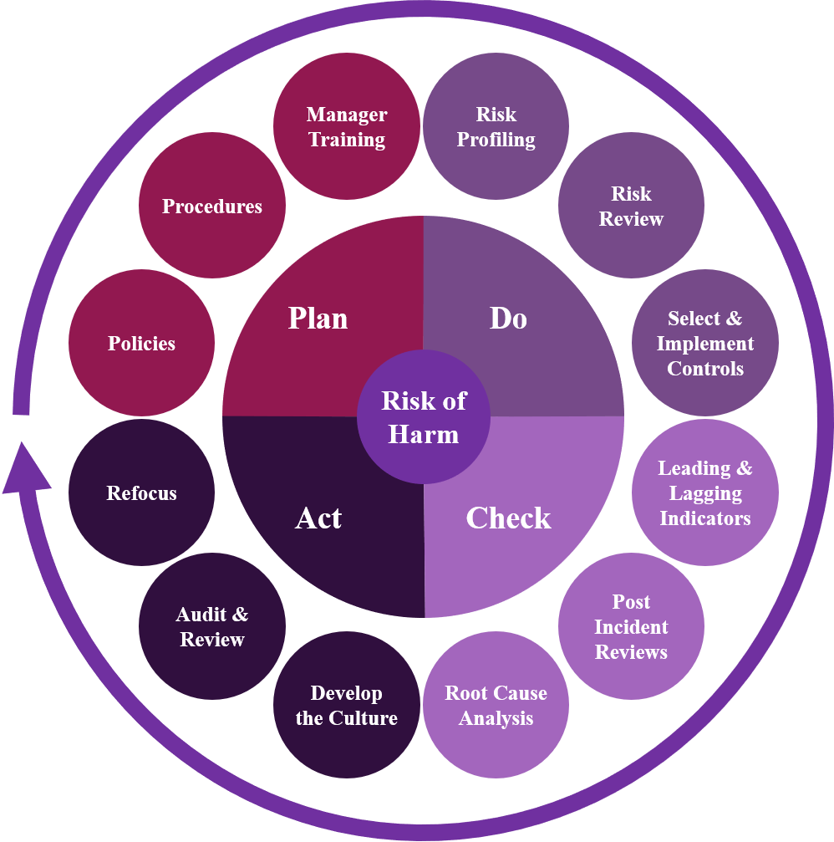
Notes:
This is what an effective work-related road risk management process looks like; it is based on the proven health & safety management process of Plan, Do, Check, Act.
You’ll notice that it is an on-going process. At first, you will address any identified high risk areas, but as you re-visit the process, you can check to see if your management program is effective, re-focus if necessary, and also take into account any emerging risks (e.g. changes in vehicle technology or legislation) and changes to your operations that will change the risks drivers face (e.g. relocating depots or offices, acquiring new businesses etc.).
It is beyond the scope of this training program to look into this process in depth, but some of the key elements would be the development of policies & procedures along with Line Manager training (this course!), the use of risk assessments to get an in-depth understanding of the risks faced, allowing the appropriate management and/or driver focused interventions to be implemented, what Key Performance Indicators to measure to see how successful the program is, understanding the underlying root causes of incidents and developing the on-road safety culture.

Slide 26

Роли и обязанности непосредственного руководителя
Notes:
This section looks at what your roles and responsibilities are in the Company’s road safety program.

Slide 27
Роли и обязанности непосредственного руководителя
Лидерство
Контролирующий разум
  Реальное и воспринимаемое давление
  Устранение необходимости рискa во время вождения для сотрудников
  Нахождение правильного баланса между безопасностью и эксплуатацией транспортного средства
Notes:
In the next few slides we will look at each of these topics in turn, so that you can understand your roles and responsibilities for safe driving and also how you can influence your employees to drive safely and follow the Company’s safe driving policies and procedures.

Slide 28
Лидерство
Сильное и эффективное руководство играет решающую роль в достижение успеха вашей инициативы по безопасности дорожного движения.
Команда высшего руководства должна предоставить время, импульс и любой необходимый бюджет для вашей программы безопасности дорожного движения.
Помните, что ВСЕ менеджеры также являются лидерами - вы должны быть примером, безопасно управляя автомобилем и соблюдая все правила и процедуры.
Всегда будьте последовательны со всеми сотрудниками…
Notes:
As with most aspects of business, leadership is critical for the success of any initiative.
When we talk about leaders, we often think of the senior leadership team, and of course they are important to provide the time, impetus and any necessary budget for your road safety program.
But all managers are also leaders, and it is important that everyone – from the senior leadership team to all of you, are seen to be driving safely and following the safe driving policies and procedures. If you have one set of rules for your employees and one set of rules for leaders and managers, there is little chance that drivers will think that you are taking safe driving seriously…
You also need to be consistent – all employees must be subject to the same rules and procedures, regardless of how valuable they are to the business. It is no use saying that you will overlook one employee’s bad driving as they are so good at their job – this will send out a negative message to his or her colleagues…

Slide 29
Контролирующий разум
Вы имеете большое влияние на поведение сотрудников во время вождения
“То что интересует моего менеджера, интересует меня”
Важность предоставления последовательных сообщений, чтобы сотрудники действительно понимали важность безопасного вождения и то, как это согласуется с их другими целями.
Notes:
What do we mean by ‘the controlling mind’?
An employee’s manager has a big influence over how they behave; the saying, “What interests my manager, interests me” sums this up nicely. As such, if the message we give to our employees is that they should follow the safe driving policies and procedures BUT it is more important to hit operational targets, then how will the employees drive if they are faced with a choice? They are likely to take risks to achieve the operational metric.
Given that managers and supervisors have so much influence over their direct reports, whether they realise this or not, it is critically important that you always drive safely and give consistent messages out so that employees really understand the importance of safe driving and how that fits in with their other objectives.

Slide 30
Внедрение правил и процедур безопасного вождения
Вы должны применять правила и процедуры безопасного вождения.
Вы должны убедиться, что ваши сотрудники понимают их и следуют им
Notes:
Line Managers and Supervisors are also responsible for actually implementing the safe driving policies and procedures. These will have probably been written by someone else, but you need to take ownership of them and, critically, ensure that your employees understand them and are following them.

Slide 31
Нахождение правильного баланса между безопасностью и эксплуатацией
Какие риски будет допускать ваш бизнес? Исходя из этого, вы определяете, на какие риски могут пойти ваши сотрудники для достижения бизнес-цели, а какие недопустимы и подлежат строгому контролю со стороны руководства.
Здесь нет правильного или неправильного ответа - это зависит от того, где, ваш приоритет для безопасного вождения.
Вам придётся часто менять рабочие процедуры и методы, чтобы позволить сотрудникам безопасно управлять автомобилем ...
Notes:
This is probably the biggest issue, and is linked to the controlling mind. You need to understand what risks the business will tolerate, and in that environment, you can determine what the safety-operational balance is; that is, what risks you allow employees to take to achieve a business goal, and which are unacceptable and subject to strict management controls.
There is no right or wrong answer here – it depends on where, as an organisation, the priority for safe driving is, and what operational changes you are willing to make to allow employees to drive safely (e.g. having employees work shorter hours to help manage fatigue when driving).

Slide 32
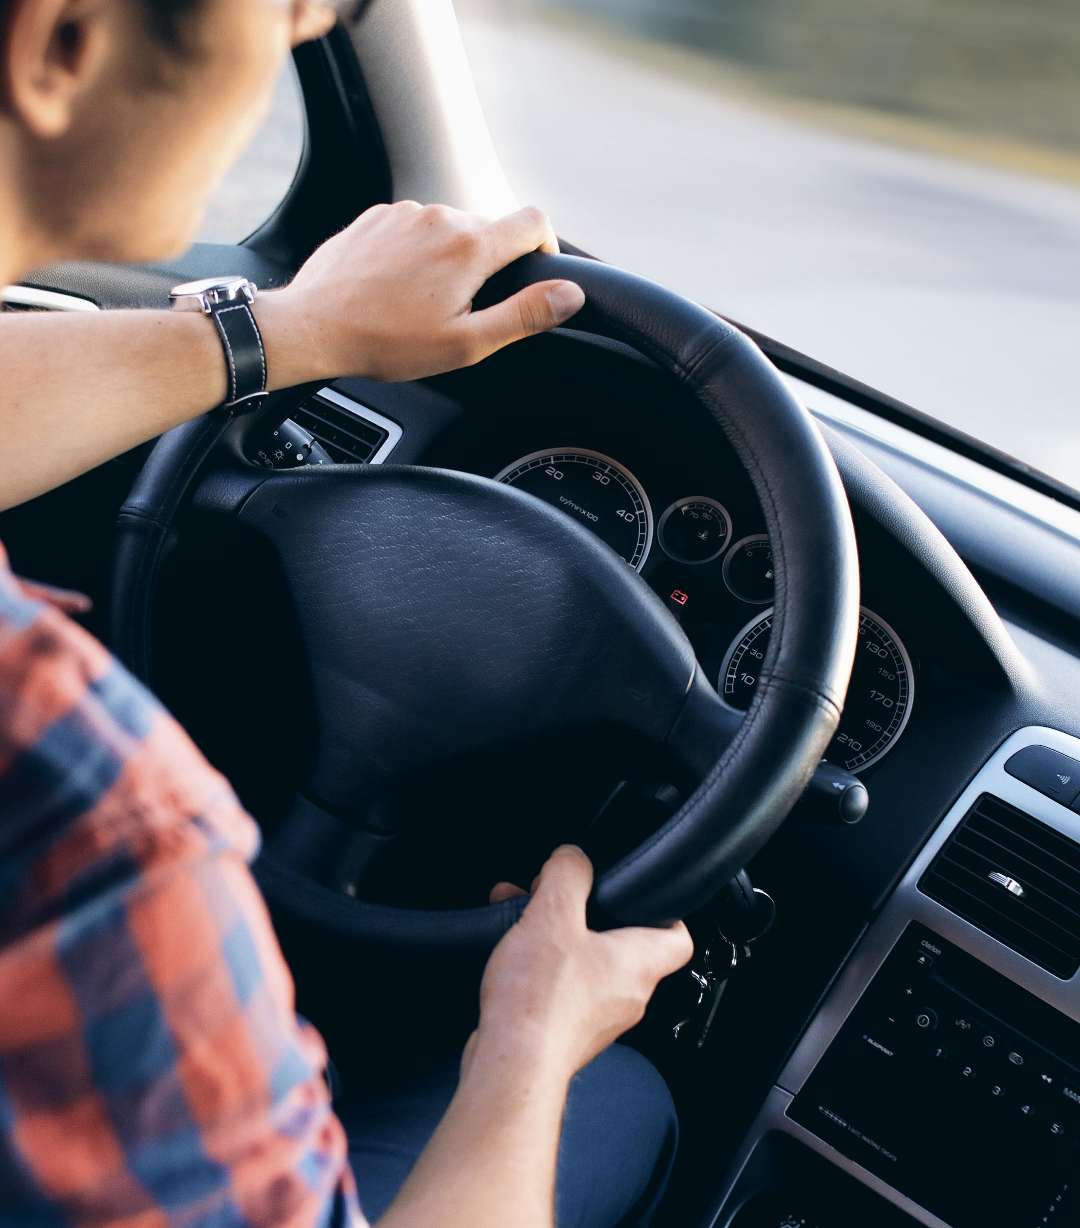
Взаимодействие с водителями
Notes:
Given that Line Managers and Supervisors have such an important role to play in the success of the Company’s road safety program, it is important to be able to effectively engage with your drivers, as part of your regular contact with your employees.

Slide 33
Взаимодействие с водителями
Вождение - очень эмоциональная проблема!
Нужно использовать нейтральную речь / не переходить на обвинения»
Используйте факты
Начальство должно соблюдать все правила и процедуры безопасного вождения, а также безопасно управлять автомобилем.
  Не звоните водителям, если вы знаете, что они будут за рулём!
Рассмотрите более углублённое очное обучение сверх этого ресурса
Notes:
The first thing to say is that driving is a very emotive issue – most people tend to over-estimate the standard of their driving, and it is difficult to criticise them!
This is where the language you use is important. Don’t talk about who was at fault for the collision but instead discuss what the driver could have done to prevent the collision from occurring, regardless of which road user made an error.
Wherever possible, use data as the basis for your conversations. This could be collision reports, driver behaviour telemetry or any other reliable source of data – it is difficult for a driver to argue with undisputed facts.
Try and spend time with employees when they are driving, to experience for yourself how they drive.
As already mentioned, make sure that you are always seen to be driving safely, and don’t enable drivers to take risks, such as calling them when you know they will be driving.
This is an important issue, so consider some more in-depth training on this.

Slide 34
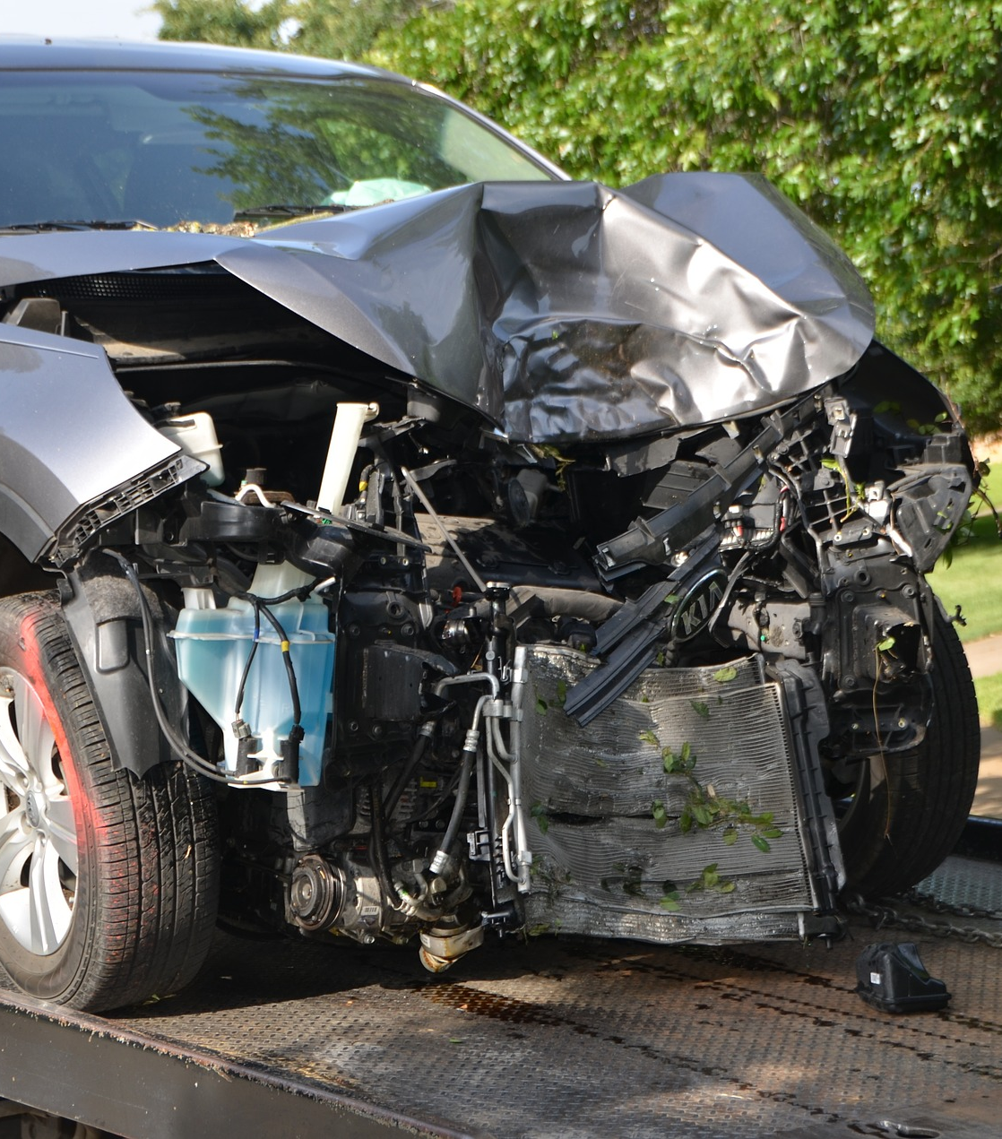
Опросы после происшествия
Notes:
We’re going to look at what you can do when a collision or incident has occurred.
This is one of the most important tasks for a Line Manager / Supervisor, to understand what the underlying root causes are of the collision.

Slide 35
Опросы после происшествия
Важная часть любого эффективного процесса управления дорожными рисками, связанного с работой
Необходимо определить основную причину / причины инцидента
Используйте инструмент анализа после инцидента, чтобы помочь с отчётом
Определите подходящее вмешательство для руководства и / или водителя, чтобы помочь предотвратить повторение инцидента
Может потребоваться дополнительное очное обучение сверх этого ресурса…
Notes:
You should talk to the driver, using neutral language and any facts about the incident, to understand what happened and to try and determine the underlying root causes. It is always important to ask yourself:
What have we done, as an organisation and/or management team, that may have contributed to the collision occurring?
This is a difficult question to consider but a powerful one – the crash may have been caused by bad driving, but it is equally likely that the behaviours exhibited by the driver in the run-up to the crash were due to some operational requirements or business objectives. Use the post-incident tool to help you with these debriefs.
Choose the appropriate intervention, based on what underlying root cause you determined, to help prevent reoccurrence. Remember that this is just as likely to be a management intervention as one focused on the individual driver…
This is another area where additional training will help ensure that you can carry out post-incident debriefs effectively.

